Slide 1



Slide 2
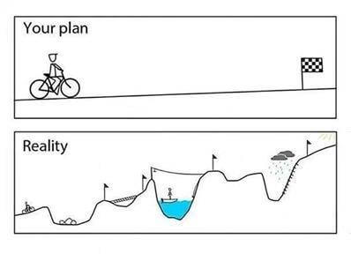
Control Plan

Slide 3
Control Plan
Control Plans:
Control the risks identified in the P-FMEA (High RPNs)
A structured approach to control process and product characteristics
Focusses on Customer Requirements
Assure reaction plans are in place in case of out-of-control conditions
Provide a central document for communication of control methods
A Control Plan contains following key information:
Identification of the control factors
The specifications and tolerances
The measurement system
Sample size and frequency
The control method
The reaction plan
Control Plans are living documents, just like FMEA’s
3

Slide 4
Control Plan, Objectives
Objectives of the training:
To understand the use of a Control Plan
To learn the steps to develop a Control Plan
To learn how to link each control plan step to the FMEA
4

Slide 5
Control Plan, Summary
Control Plan, a systemic way to Control a process:
Define Characteristics per process step:
Machines, Devices, Jigs and Tools
Product, Process and Special characteristics
Define Methods per process step:
Process and Product Specifications and Tolerances
Measurement and Inspection techniques
Sample size and frequency
Actions that should be taken in case of Non-Conformities
5

Slide 6
Control Plan, Summary
Control Plan, a systemic way to Control a process:
Verify if defined steps are followed
Audit the process by Control Plan on a regular base
Update the Control Plan consistently
6
Page 6

Slide 7
Control Plan, Inputs
Control Plan, inputs might include following tools:
FMEA
Flow Chart (process sequence)
Lay-out Plan production line
Sequence Of Events
Part Number/ Tooling / Tool List
Assembly Drawing
Specifications/ Dimensions/ Tolerances
CTQ List
Process Map
Historical OMS
7

Slide 8
Control Plans, Planning
A build
B build
Pilot
SOP
Drawing
Issue part approval form
Tool development
FMEA + control plan
Fit / performance
Conditional approval
HVPT approval
Part approval
Purchasing
SQE
QA
Source
SQE approval
Quality and capacity confirmation
HVPT process approval
Issue HF PA requirements
HF proto part approval
MF and LF part receipt
HF full part approval (OT/OP)
Inspection OK – NOK send CAR’s
VCB approval

Slide 9
Control Plans
Prototype
Pre-launch
Production
Control Plan Number
Key Contact/Phone
Date (Original)
Part Number/Latest Change Level
Core Team
Date (Revised)
Part Number / Description
Plant / Supplier Approval Date
Customer Eng.'s Approval / Date (if Required)
Plant / Supplier
Supplier Code
Other Approval / Date (if Required)
Customer Quality Approval / Date (if Required)
Characteristics
Methods
Part /
Process
Number
Process Name /
Operation Description
Machine Device
Jig. Tools
for Manufacturing
Special
Characteristics
Class
Sample
Reaction
Plan
No.
Product
Process
Product/Process
Specification
tolerance
Evaluation
Measurement
Technique
Control
Method
Size
Freq.
1
2
3
4
5
6
7
8
9
10
11
12
A
B
C
D
Operation
Characteristics
Methods
Reaction
Plan
Advanced Product Quality Planning (APQP) Reference Manual, QS-9000

Slide 10
Control Plans
What is being done?
A
Operation
1. Part/Process Number:
Usually referenced from the process flow chart, PFMEA or Tool sheets
2. Process Name/Operation Description:
Identify the process/operation that best describes the activity being addressed (e.g. work elements)
Use verb / noun format
3. Machine, Device, Jig, Tools for Manufacturing:
Identify the processing equipment required. (e.g.. machine, device, jig power tools, assist arms, conveyors, etc.)

Slide 11
Control Plans
What is Important?
B
Characteristics
4. Number:
Identifies the cross reference number from the applicable documentation.
5. Product Characteristic:
Distinguishing features and/or attributes
6. Process Characteristic:
Characteristics of the process
7. Special Characteristic:
key processes (e.g. Delta K, QS)

Slide 12
Control Plans
Characteristics: Identify Product and Process characteristics for each Control Plan step
PRODUCT CHARACTERISTIC
physical properties of the part
Identified important customer characteristics (CTQs and Delta-K)
Examples: length, width, tensile strength, torque, weld integrity, color, alignment, etc.
PROCESS CHARACTERISTIC
identify characteristics, which when controlled, reduce variation in product characteristics
Examples: pressure, temperature, force, feed rate, RPM (torque), etc.
A description of the state of the component or vehicle after the particular operation is completed
Related to product characteristics

Slide 13
Control Plans
C
Methods
What is the Means for Controlling?
8. Product/Process Specification:
Specifications/tolerance for a part or process. (eg. may be obtained from various engineering documents)
9. Evaluation/Measurement Technique:
Identifies the measurement system being used to measure product/process characteristics. (eg. gages, fixtures, test equipment, blocks, go/no go, etc)
10 / 11. Sample Size/Frequency:
List sample size and frequency to perform evaluation. (eg. size: 4 pieces / frequency: fifth time per shift)

Slide 14
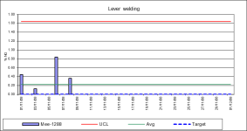
Control Plan, Sample size and frequency
Until a process is Capable (Cpk 1.33), 100% Inspection is required
If process is Capable, define Sample Size and Frequency reflecting acceptable risk
Use Six Sigma tools and techniques to control the Process
Counting Defects
SPC Chart
C-Graph of Defects
Capability Graph

Slide 15
Control Plans, Control Method
C
Methods
12. Control Method:
Brief description of how the operation will be controlled
When selecting the method of control, focus on:
process control rather than product control
prevention rather than detection
targeting nominal rather than specification limits
Examples:
Check sheets (weld, quality, tool, material, etc)
Preventative tooling maintenance
Variation control charts
Error/mistake proofing
SPC charts

Slide 16
Control Plans, Reaction Plan
D
Reaction Plan
13. Reaction Plan:
Specifies who to inform to make a decision or what to do when a process goes out of control
Written for people closest to the process (e.g. replace a drill)
Review systemic root cause and update the FMEA
Examples:
Call supervisor
100% Inspection until the process is back in control
Calibrate equipment

Slide 17
Control Plans, Plug Example

Slide 18
Control Plans, Next Steps
Next Steps to HYMH Suppliers:
Know your customers’ expectations - CTQ’s (Critical to Quality Characteristics)
Have a defined and documented production process (SOE)
Follow 5S Principles
Employ a formal training system
Involve the people on the shop floor
Audit the production process constantly
Manage supplied parts and control supplier performance
Measure/monitor key quality performance indicators
Use an effective Corrective & Preventative Action Process
FMEA and Control Plans are mandatory for PPAP submission level 3.

Slide 19
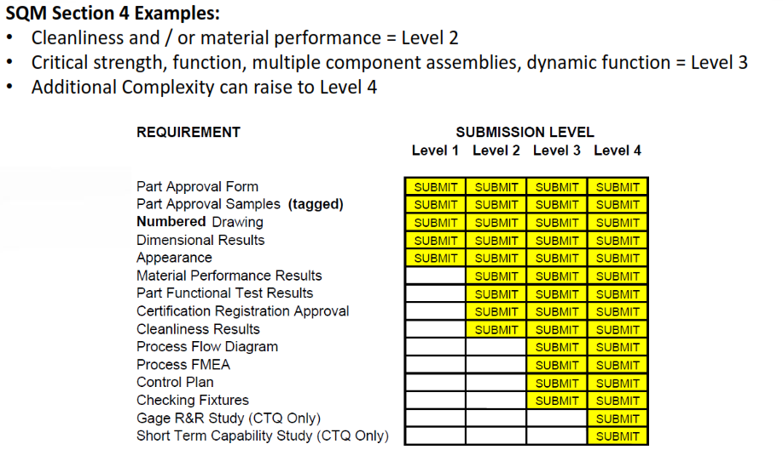
Control Plans, Next Steps

Slide 20
List of acronyms:
CTQ: Critical To Quality, a characteristic judged to be important to the fit and function of a component or assembly as well as customer satisfaction
FMEA: Failure Mode and Effect Analysis
ICAM: Interactive Corrective Action Management
OMS: Operational Method Sheet
Off Tool: (Production Tooling) - When a part is said to be “Off Tool” it is required that the part be manufactured using the exact tooling which will be used for long-term production. This does NOT mean the parts were manufactured from tooling that is “like” or “similar” to the intended production tooling.
Off Process:(Production Process) – When a part is said to be “Off Process” it is required that the part be manufactured and tested using the exact process that will be used for long-term production. This does NOT mean the parts were manufactured using a “like” or “similar” or less than 100% completed process.
P.A.: Part Approval process to determine if part characteristics and specifications are understood and met by the supplier.
PCR: Process Change Request
PFD: Process Flow Diagram
SQM: Supplier Quality Manual
QFD: Quality Function Deployment
QS-9000, PPAP: Product Part Approval Process
QS-9000, APQP: Advanced Project Quality Plan

