Slide 1

Training - Completing ICAM For Suppliers

Slide 2
Index
Subject Slide
Best Practice 3
Frequently Asked Questions (FAQ’s) 4, 5, 6
Log in 7
Windows 10 8
IE 11 Compatibility Issue 9, 10
Change Log In Password 11
Set up/Change E-Signature 12
Changing Newsletter Preferences 13
Editing and Saving Information 14
Check/Change Access Rights 15
Adding Attachments/References 16
Using E-mail within the ICAM 17
CA Status 0 – Acceptance 18
CA Status 1 – Containment Actions 19, 20, 21
CA Status 2 – Root Cause 22, 23, 24, 25, 26, 27
5th Why Checklist 28
9 Ways to Define, Improve and Control Quality 29
CA Status 3 – Permanent Corrective Action 30, 31, 32
CA Status 4 – Supplier Verification 33
Logging Out Safely 34
Removing Notifications 35
Additional Help 36
ICAM Questions to Verify Completeness 37

Slide 3
Best Practice
To ensure that the ICAM is completed correctly within the HYMH timeframe, these comments describe the BEST PRACTICE that should be followed.
Acceptance should be completed within 24 hours. This is not acceptance of the issue; it is a signal to show HYMH that the issue has been picked up by a representative of your company. (See slide 18)
Containment action should be completed within 2 working days. Containment actions should fully protect the customer (HYMH) from this issue until implementation of Permanent Corrective Actions. (See slides 19, 20 and 21 for guidance)
Root Cause investigation should be completed within 10 working days. At minimum, full 5 why analysis should be conducted for both ‘Why Made’ and ‘Why Shipped” (not detected)’. HYMH requests that a ‘5 Why’ sheet be used for Root Cause investigation and that this be uploaded as an attachment in the “References” section. A template will be in the References section and a good sample can be seen on Slide 24, you can also use an 8D report if this has a 5 why section. (See slides 22-27 for guidance)
Permanent Corrective action should be completed within 30 working days. Permanent corrective actions must address the real root causes of the issue and should normally require a change to, or creation of, paper documentation (e.g. work instruction, training plan, production procedure, drawings, etc.). It is required that evidence of the permanent corrective actions be attached in the Reference section of the ICAM. (See slides 30, 31 and 32 for guidance)
Note: Separate corrective actions are almost always required to address both the why made and why not found root causes. The supplier should also confirm that the corrective action taken ensures prevention of recurrence of this issue and similar issues on this and comparable product

Slide 4
Frequently Asked Questions (FAQ’s)
What is an ICAM?
Stands for Interactive Corrective Action Management. This is a web-based system which allows Quality issues that have affected HYMH to be raised and managed by the Supplier and HYMH Quality Teams.
Why did I receive this ICAM?
You received this ICAM following a decision by the HYMH Quality teams that the issue had a significant effect on production or our Dealers. In general, there are three criteria for an ICAM to be opened. Please note that not all fails will result in an ICAM.
Cost – If the quality cost for the parts and/or rework is significant.
Quantity – If the quantity affected is multiple/batch related.
Dealer/Customer/Production issue – Any failure reported that is deemed to be significant by the HYMH Quality Team.
I am no longer accountable for ICAM’s, how can I change ownership?
If you are no longer in charge of managing ICAM’s for your company, then please look in the “Nonconformance” section of the ICAM and get the name of the HYMH coordinator. Against the name will be an information button to get their e-mail details to contact them and provide them with a new contact to manage the ICAM.
I have forgotten my Login/Password?
If you have forgotten your login or password, then please contact anyone from the HYMH Quality department who will in turn contact the ICAM administrator to reset the account and provide the login details.
I am running Internet Exployer 11 and cannot login?
When running the ICAM system using Internet Explorer 11, there is a known compatibility issue, follow the steps in the guide from slide 9 and 10 to resolve.

Slide 5
Frequently Asked Questions (FAQ’s)
How can I change my Login Password?
Your initial login password is set by the ICAM administrator and is common across the system, when you log into the system follow the instructions on slide 11 to change your password to one that you will easily remember.
What is an E-Signature?
An E-signature is basically a second password which you need to set up when you first get your account, follow the instructions on slide 12 to set it up. You will require an e-signature, as you need it to electronically sign each section so that the HYMH QA owner knows a section has been complete and the system moves onto the next phase.
I cannot enter any text in the Root Cause and Supplier Verification fields?
The text boxes in these sections are locked and require the “Edit” button to be selected on the top tool bar, see slide 14. Please note when you finished be sure to hit the “Save” button on the tool bar to keep your work.
How long do I have to provide a complete answer to this ICAM?
Each section has its own target, please see the Best practice slide for details. It can be summarized as follows.
Acceptance – must be within 24 hours.
Containment actions – must be complete within 2 working days.
Root Cause – target is within 10 working days.
Permanent Corrective Action – target is within 30 working days.

Slide 6
Frequently Asked Questions (FAQ’s)
I cannot upload my file to the reference section?
The references section will accept all Microsoft files and picture extensions, but the size of a file is limited to 10 Mbyte. If your file is above 10 Mbyte look at options to reduce the size, reduce the resolution of pictures or save the file in PDF format.
I am not receiving the daily e-mail?
There are two reasons for not receiving the daily e-mail.
- You have no notifications in your account or open actions.
- The system is down as it is a third-party S/W, please contact HYMH if you have concerns.
How can I stop receiving the daily e-mail as I have completed my actions?
The reason the e-mail is issued is to advise that you have notifications in your ICAM account, please follow the instructions on slide 35 to remove these notifications if you have completed your tasks.
I have completed all the sections, but the ICAM is still open?
Each ICAM is split into five sections, as the Supplier contact you are responsible for the first four sections, (Acceptance, Containment, Root cause and Permanent Corrective Action). The last section is the Closure, which must be completed by the HYMH Quality Prime that is assigned to the ICAM. If they feel that there is some information missing or need clarification, they will be in touch to advise what is required before they agree to close.
Do I have to use the HYMH 5 Why template in the Reference section?
For each ICAM, HYMH request that a 5 Why template is filled out and uploaded into the references section. If your Company has it’s own 5 Why template or use an 8D report which includes a 5 Why template, then these can be used also. The HYNH template is just added to cover any Suppliers that do not have an active template.

Slide 7
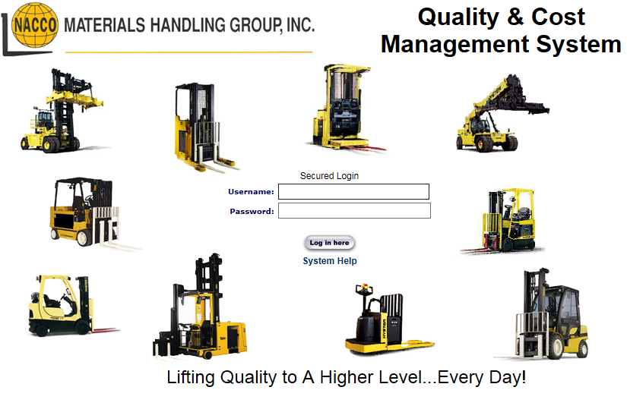
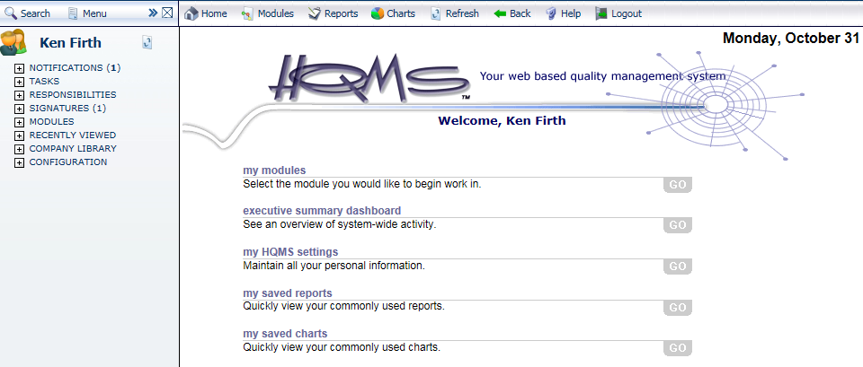
Log in
Go to https://hqms.hgihost.com/nmhg/login.aspx
NOTE:
Please use a version of IE (Internet Explorer) at least version 5.5 or above.
It will not work with the following:
Chrome
Firefox
MAC IOS
1. Enter your Username and Password
2. Click “Log in here”
3. The main screen should appear.

Slide 8
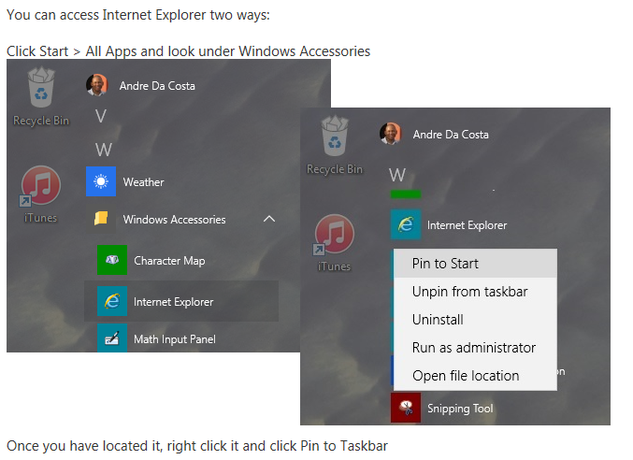
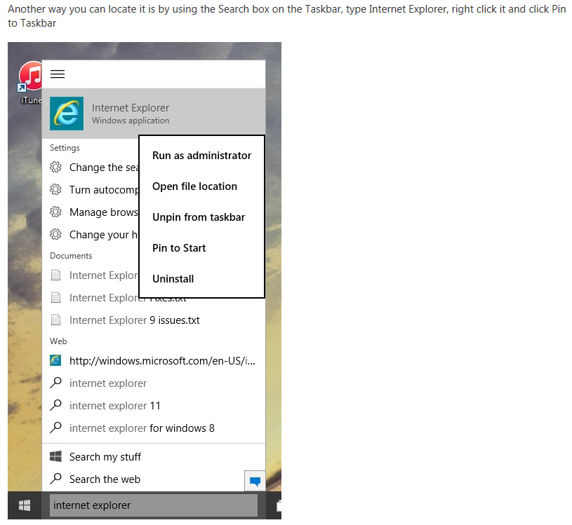
Windows 10
If your computer is running the Windows 10 operating system, the HQMS programme will not open, as it is incompatible with Microsoft Edge, which is the default Internet explorer. To resolve this, you need to activate IE 11 (Internet Explorer 11) in Windows 10; please follow either of the instructions below.
Option 1
Option 2

Slide 9
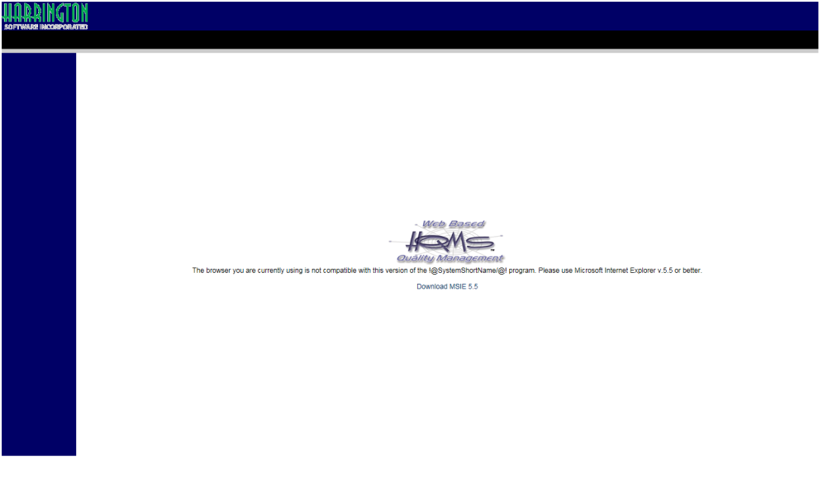
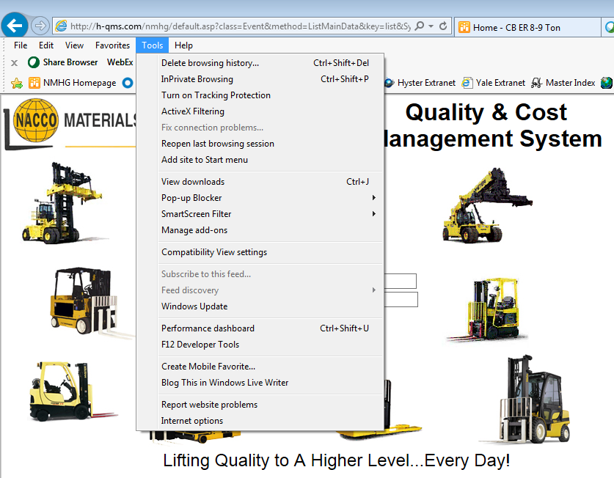
IE11 Compatibility issue
If you see this screen when you go to the HQMS address, please follow these steps. Currently, the system is not compatible with IE11 but this fix should resolve it.
1. Click on “Tools”.
2. Then click on “Compatibility View Settings”.

Slide 10
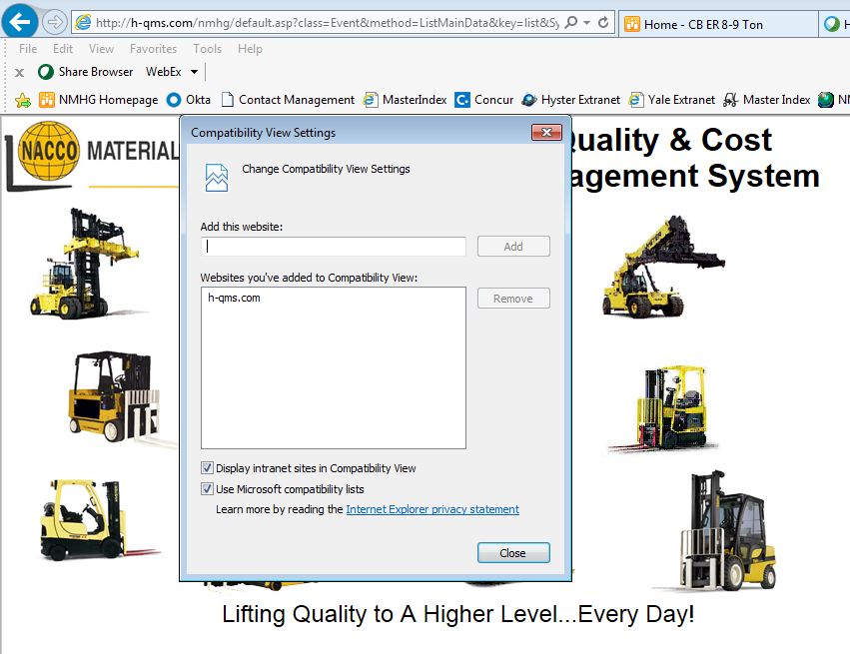
IE11 Compatibility issue
3. Click on “Add”.
4. The HQMS address will appear here.
5. Click “Close”
6. Close your IE window and restart.

Slide 11
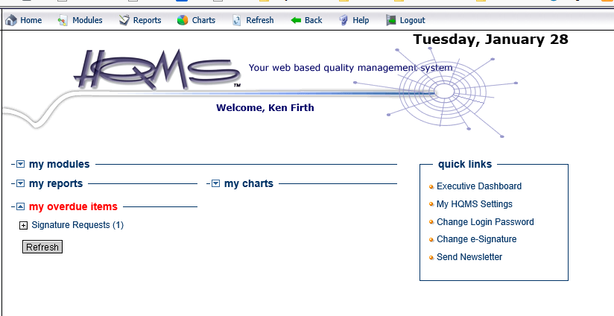
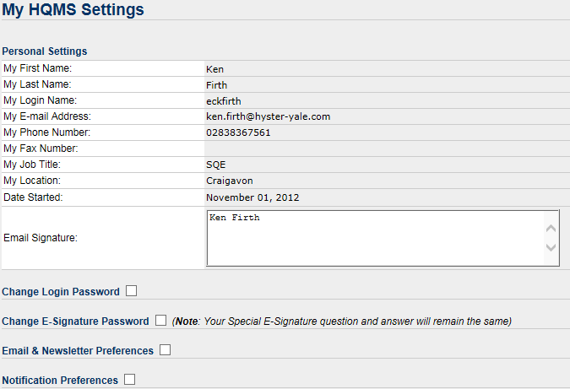

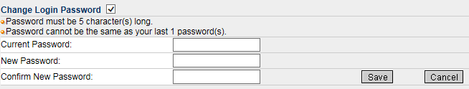
Change Log In Password
1. Click on “my HQMS settings”.
2. Select the tick box beside “Change Login Password”
3. Enter your current password, then your new password details and click on “Save”.

Slide 12
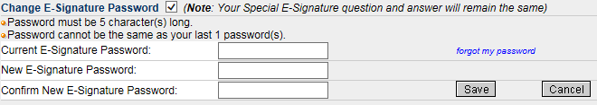
Set up/Change E-signature
1. Click on “my HQMS settings”.
2. Select the tick box beside “Change E-Signature Password”
3. Enter your new/current password, then your new password details and click on “Save”.

Slide 13
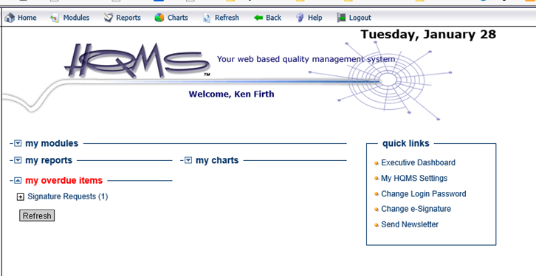
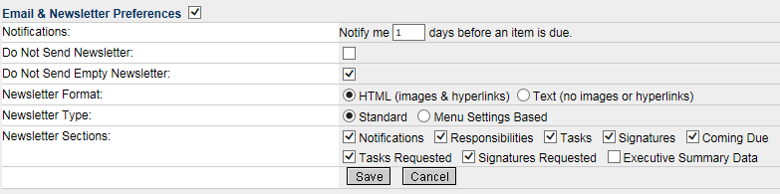
Changing Newsletter Preferences
1. Click on “my HQMS settings”.
2. Select the tick box beside “Email and Newsletter Preferences”
3. Enter in your preferences and click on “Save”.

Slide 14


Editing and Saving Information
When you are updating any of the 4 stages in the ICAM, ensure that you have selected the “Edit” button on the top tool bar.
NOTE: If you do not see the “Edit” button, please check your access rights by following the instructions on Slide 15.
Once you have finished adding your information, please ensure that you click on the “Save” button on the top tool bar or you will lose your updates.
Please be aware:
If you leave the ICAM system idle for 17 minutes, it will automatically be logged out and you will lose any information that was not saved.
When finished, save your work and log out.

Slide 15
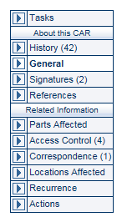
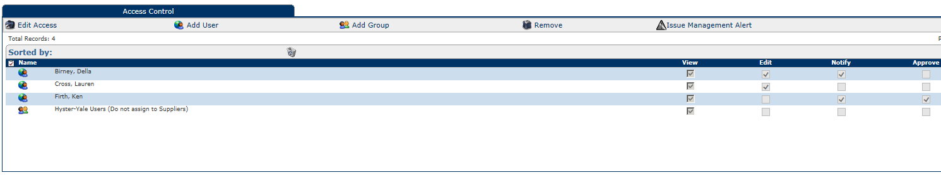

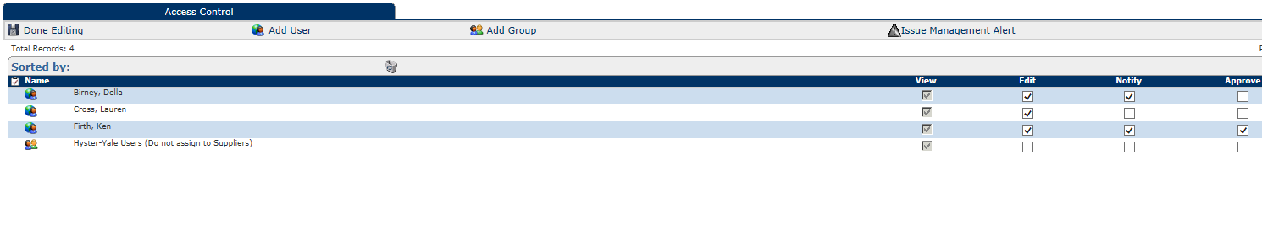
Check/Change Access Rights
On the right-hand side of the ICAM you will see a number of options: select “Access control”
If the “Edit” checkbox is not selected then do the following.
Click on “Edit Access”.
Click on the Edit checkbox until a “ “ appears.
Click on “Done Editing” and this will resolve the problem.
NOTE: If you cannot perform this action, please contact the HYMH representative on your ICAM for help.

Slide 16
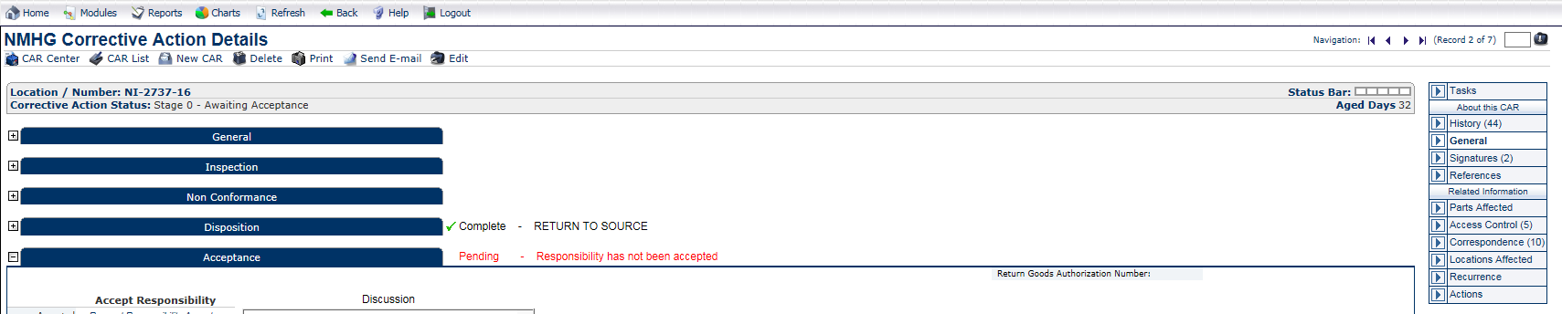
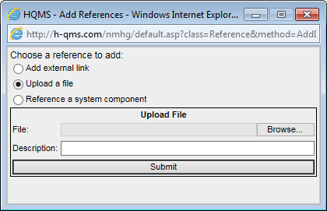
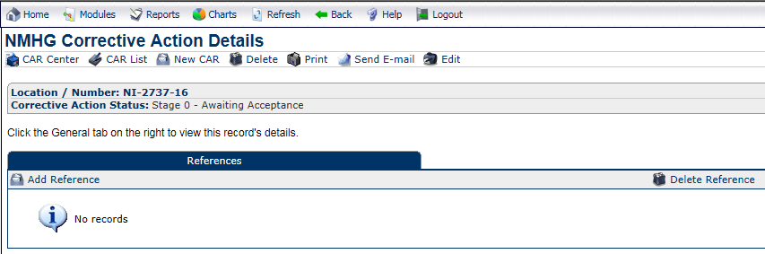

Adding Attachments/References
If you have additional information, in pictures or documents, to share with the ICAM, click on “References” on the right hand side.
Click on “Add reference”.
Browse for the file or item location, choose the item and click “Submit”
NOTE: Most Microsoft application files can be uploaded, including picture extensions, but they are limited to 10Mb per file; you may upload multiple files.
The best format to use is PDF.

Slide 17

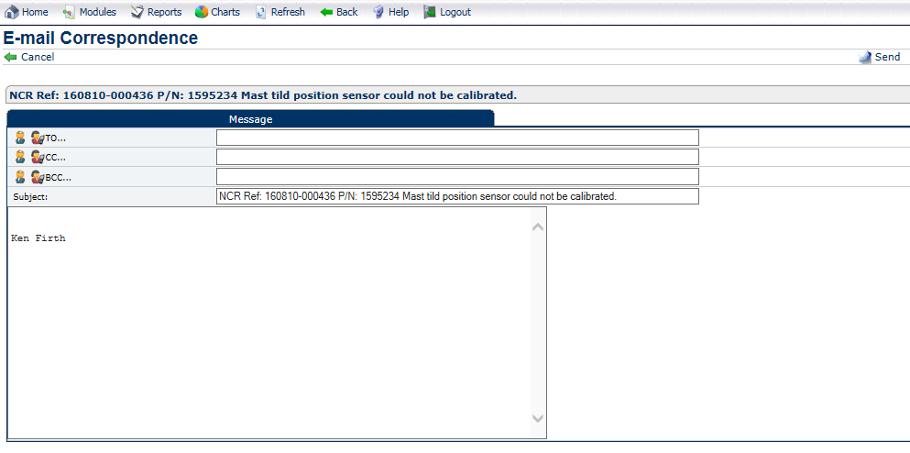
Using E-mail within the ICAM
If you wish to communicate a query or an answer to the ICAM prime (the HYMH person who created the ICAM), please do so via the “Send E-mail” function. Click on “Send E-mail”. This ensures that all communication, related to the ICAM, is available to all parties involved.
Enter the e-mail address of the HYMH prime (the HYMH person who created the ICAM). Multiple addresses should be separated by a semicolon (;)
If an email address is not known, use the search facility.
Type your message.
Press Send.

Slide 18
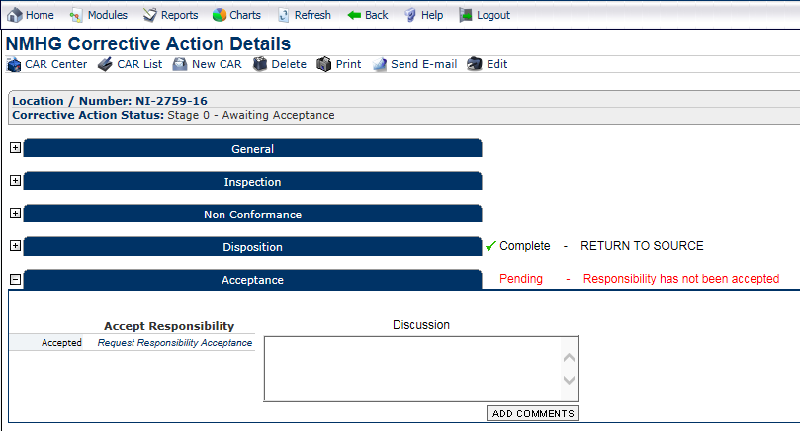
CA Status 0 - Acceptance
Acceptance should be complete within 1 day.
“Accept Responsibility”: Use your e-signature to accept the ICAM.
Please note that accepting the ICAM does not mean that you are accepting responsibility for the reported fault; it only means you are accepting ownership of the ICAM, as the main contact person, and that you will investigate and update the report.
The key to accepting the ICAM within 24 hours is to show HYMH that the person assigned from your company has seen the ICAM and is working on the investigation.

Slide 19
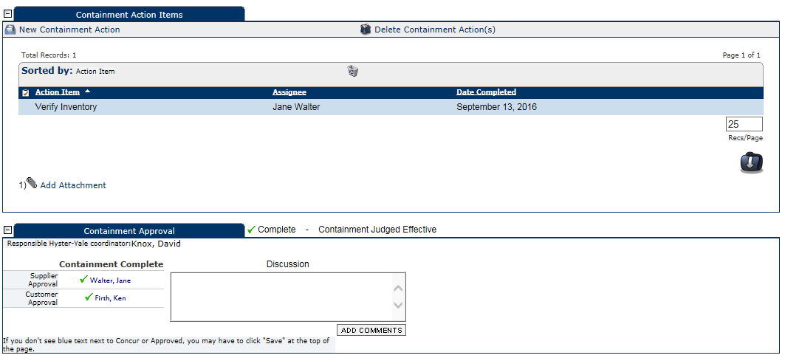
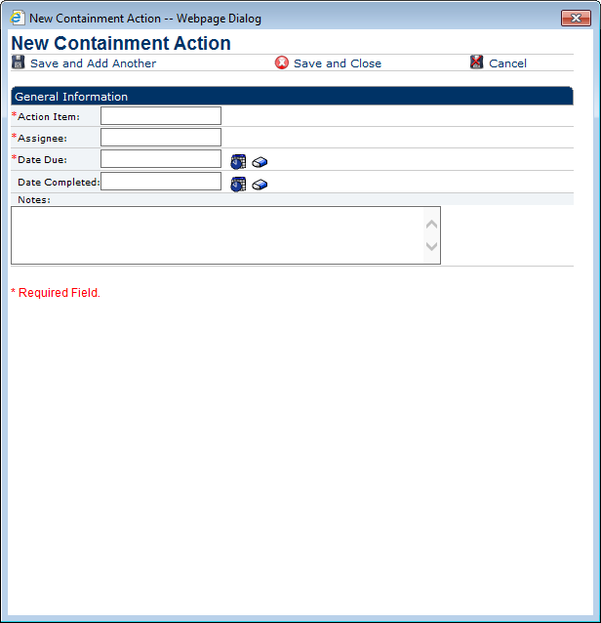
CA Statis 1 – Containment actions
Containment actions should be complete within 2 days.
How to add a Containment Action
6. Select “Save and Add Another” or “Save and close”.
3. “Action Item”: Fill out the action item details; some good examples are on slide 18.
1. To add a new Containment Action, click here
4. “Assignee”: Type in the name of the person responsible to complete the action.
2. This new window will open.
5. “Due Date”: Using the date icon, to the right of the “Date Due” box, select the date when the action is due to be completed.

Slide 20
CA Statis 1 – Containment actions
Containment actions should be complete within 2 days.
Note – Do not wait until the rejected parts are returned, verify your process within 2 days.
Areas to consider:
Supplier stock. Stock in house.
WIP. FGI.
Repair Centres. Customer.
When you have finished all containment actions, use your e-signature to close this stage and the report will go to HYMH for approval to proceed to stage 2.
Containment actions should fully protect the customer (HYMH) from this issue until implementation of Permanent Corrective Actions (PCA).
Ensure that your actions cover the requirements listed in the following questions.

Slide 21
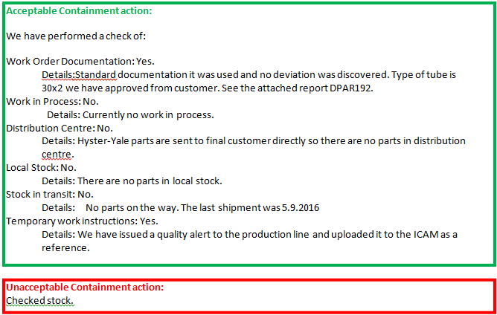
CA Statis 1 – Containment actions
Examples of Acceptable actions and Unacceptable actions
Unacceptable because there is no information on how HYMH will be protected up to the point of introduction of the Permanent Corrective action. A better answer would be “100% stock check ongoing until Permanent Corrective Action in place.”

Slide 22
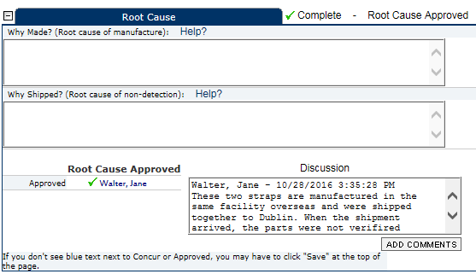
CA Status 2 – Root Cause
Root Cause should be complete within 10 working days. If the Root Cause is deemed to be an HYMH issue or the fault cannot be replicated, inform the HYMH ICAM owner to cancel the ICAM and reverse any debits associated with the claim.
Note: To add text into the Root Cause fields follow the edit instructions on slide 14.
Root cause should be complete within 10 days.
Each root cause should ultilise the 5 why approach to discover the systemic root cause and not the symptom.
Use the template on slide 20 to guide you.
When you have finished the 5 whys for the root cause and uploaded it into the references, use your e-signature to close this stage and the report will move on to stage 3.
Ensure that your root cause covers the requirements listed in the following questions.

Slide 23
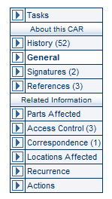
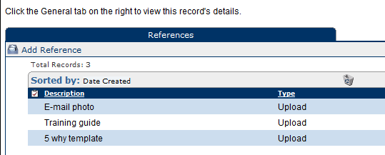
CA Status 2 – Root Cause
How to fill out the 5 Why template
1. Click on references on the left hand side.
2. Click on 5 Why template.
3. Download it to your desktop and add in your comments (See slides 25 - 27 for details).
4. When finished click on “Add reference” and attach the completed file.

Slide 24
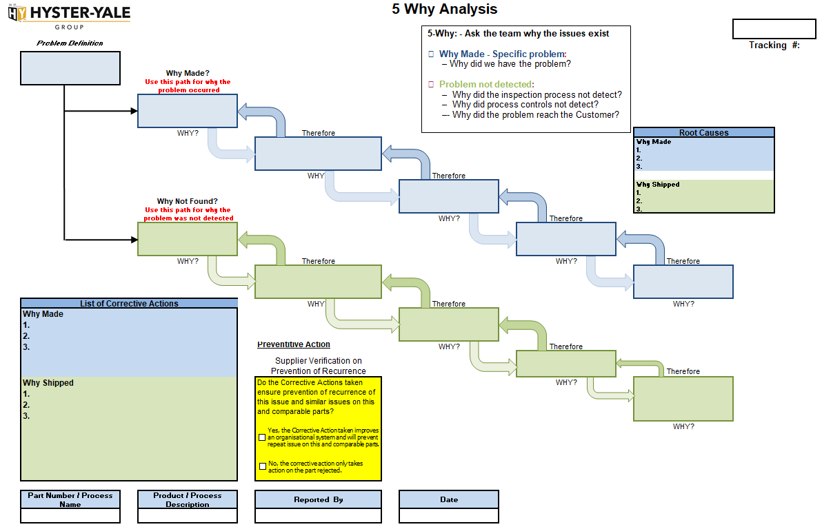
CA Status 2 – Root Cause
Please use 5 Why template in the references section or your own version to complete 5 Why investigation. See slides 26 and 27 to show good and bad examples.
Other Tools to consider:
Pareto Charts Affinity Diagram Brainstorming Session Flow Charts
5-Whys Process Fishbone Diagram Fault Tree Analysis Audits
Statistical Analysis ANOVA DOE FMEA
Regression Analysis Hypothesis Testing GR&R

Slide 25
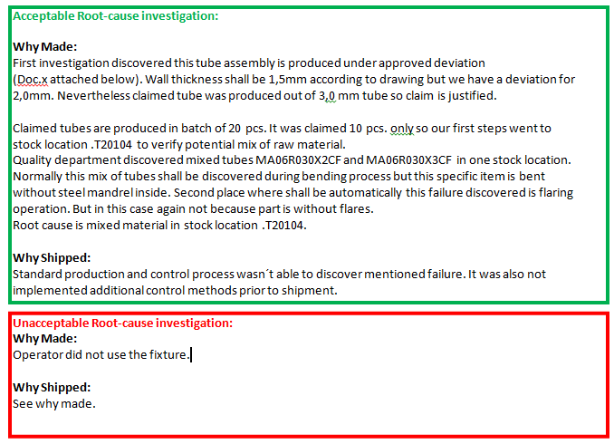
CA Status 2 – Root Cause
Examples of Acceptable actions and Unacceptable actions
Unacceptable, because there is no 5 why investigation: why did operator not use the fixture?
In addition, “Why Shipped” has not been addressed.

Slide 26

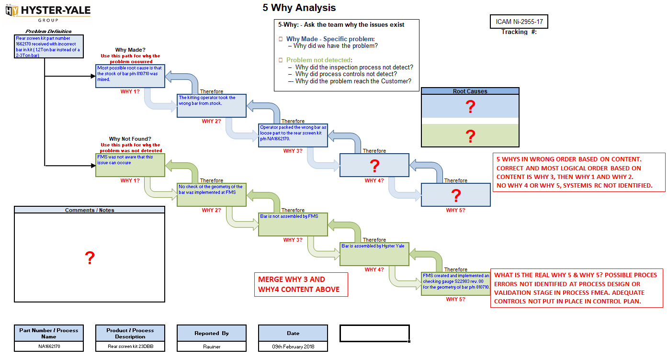
Supplier#1: Unacceptable Root-cause investigation using 5th Why Process:
In both “why made” and “why not found’’ there is no recognition of possible shortcomings in planning, setting up processes & validation. Feedback has been provided to the supplier.

Slide 27

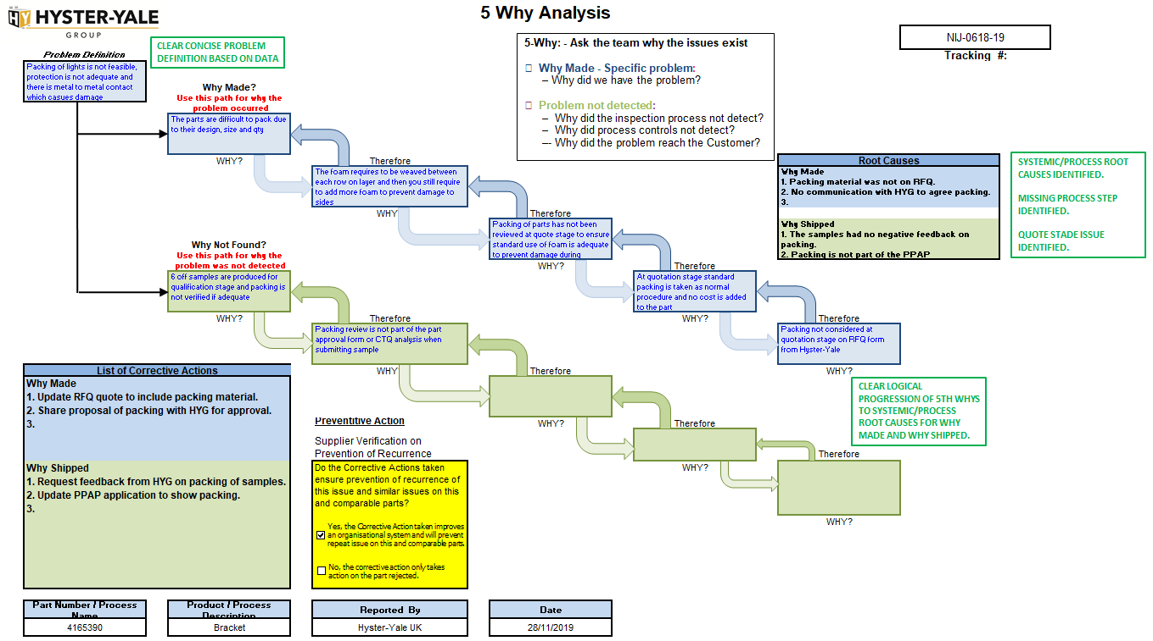
Supplier#2: Acceptable Root-cause investigation using 5th Why Process:
Clear problem definition, clear logical progression on 5th Whys, system/process RCs identified for both “why made” & “why shipped” and multiple PCAs identified: RFQ process updated, samples issued, feedback from HYMH requested.

Slide 28

5th Why Checklist
No. | Step | Completed
1 | Form the Cross-functional Team with members familiar with the process and products.
2 | Define the Problem & scope - a clear concise definition based on data.
3 | The 5th Why tool must be the live Root Cause investigation tool. Aim to get to the Systemic Root Causes, the actual Quality/Business process issues for “Why Made” and “Why Shipped” by the 5th Why. (Refer to 9 Ways To Define, Improve & Control Quality on next slide). It is not acceptable to complete a 5th Why late in the process only as part of an administration process to update documents.
4 | Ask “Why Made?”
5 | Ask “Why Shipped/Not Found?”
6 | Check that the “Whys” follow a logical path. In reverse order they should lead back to the problem definition.
7 | Develop and Implement a list of multiple Permanent Corrective Actions for “Why Made” and “Why Shipped” with owners and due dates. For example, the PCAs against the 2nd or 3rd why will likely be different that the PCAs to address the 4th and 5th why.

Slide 29
9 Ways To Define, Improve & Control Quality
Know your customers’ expectations - CTQs (Critical to Quality Characteristics)
Have a defined and documented production process
Follow 5S Principles
Employ a formal training system
Involve the people on the shop floor
Audit the production process constantly
Manage supplied parts and control supplier performance
Measure/monitor key quality performance indicators
Use an effective Corrective & Preventative Action Process

Slide 30
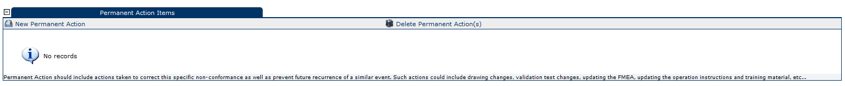

CA Status 3 – Permanent Corrective Actions
Permanent Corrective Actions should be complete within 30 days.
How to add a New Permanent Action
6. Select “Save and add another” or “Save and close”.
1. To add a new Permanent action click here
3. “Action Item”: Fill out the action item details; some good examples are on slide 32.
4. “Assignee”: Type in the name of the person responsible for completion of the action.
2. This new window will open.
5. “Date Due”: Using the date icon, to the right of the “Date Due” box, select the date when the action is due to be completed.

Slide 31
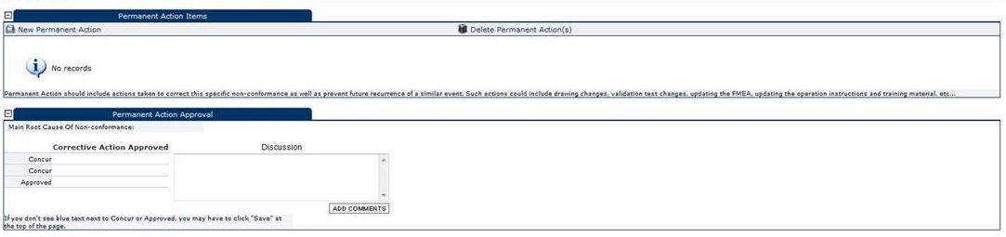
CA Status 3 – Permanent Corrective Actions
Permanent Corrective Actions should be complete within 30 days.
Criteria for choosing the best solution:
Practical - The team should be able to implement the solution practically.
Feasible - The solution must be feasible.
Cost effective - Implementing and using the solution must be cost-effective.
Robust - The solution shouldn’t fail when used in production. Robustness of the solution is an essential characteristic (error-proofing, impact-effort matrix)
When you have finished listing all the permanent corrective actions, use your e-signature to close this stage and the report will move to stage 4.
Management team must fully support Permanent Corrective Actions and facilitate their implementation.
Ensure that your actions cover the requirements listed in the following questions.
Note – Per the notes in the Permanent action item field, all corrective actions should involve creating or changing a document, work instruction, training record, etc. in the References section, please attach a copy of all documentation which was updated or generated; see slide 12 for guidance.
Note; often more than 1 corrective action will be required to address the different ‘5 why’ root causes.

Slide 32
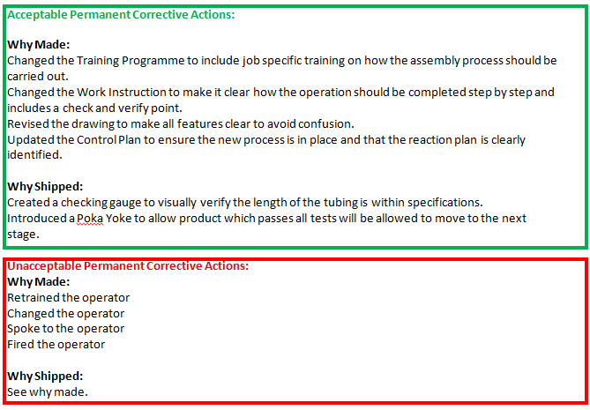
CA Status 3 – Permanent Corrective Actions
Examples of Acceptable actions and Unacceptable actions
Unacceptable, because there is no change to the process to remove the risk of this happening again. In addition, “Why Shipped” has not been addressed.

Slide 33
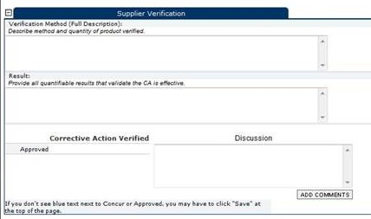
CA Status 4 – Supplier Verification
Verification should be complete within 40 days.
Note: To add text into the Supplier Verification fields, follow the edit instructions on slide 14.
Tools to be considered:
Control charts Control plans Histogram
Capability Analysis FMEA GR&R
*Note: Include a serial break or a date code reference from when the permanent corrective action was implemented.
When you have finished listing your verification details, use your e-signature to close this stage and it will be sent to HYMH for a closure request.
Ensure that your verification covers the requirements listed in the following questions.
 | Verification Checkist Questions | Yes | No
15 | Has new stock been received without issues?
16 | Have audits established the effectiveness of the solution and confirmed that the problem has been solved?
17 | Have the changes been applied across similar operations to prevent occurrences?
18 | Are all necessary controls for the solution in place?

Slide 34
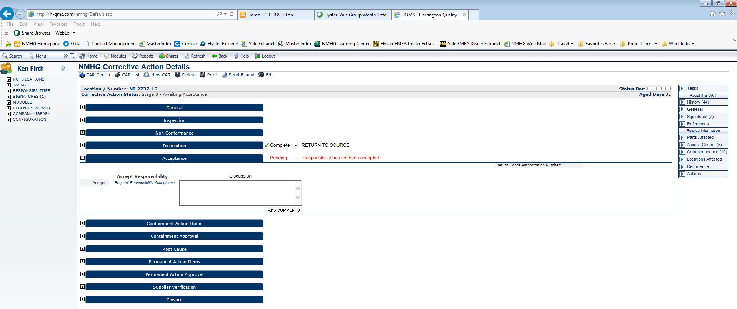
Logging out Safely
When you have finished your updates, click on “Save” and then “Logout”
NOTE: NEVER exit the ICAM by closing the tab or the program. If you do, it will keep you logged into the ICAM and no-one else will be able to make any updates.

Slide 35
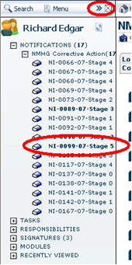
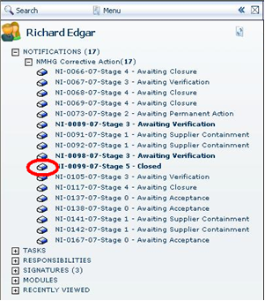
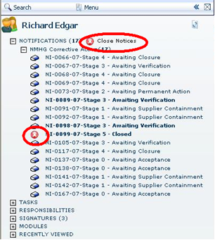
Removing Notifications.
You will receive a daily e-mail from the system to advise you of all the ICAMs and actions that are assigned to you. After the ICAM has been closed/cancelled at Stage 5, remove it from your notifications list. If you clear them all you will not receive any further notification emails.
This ICAM is shown at Stage 5.
Click on the ICON beside the ICAM.
The ICON will change to red; click on “Close Notices” at the top and the notification will be removed.

Slide 36
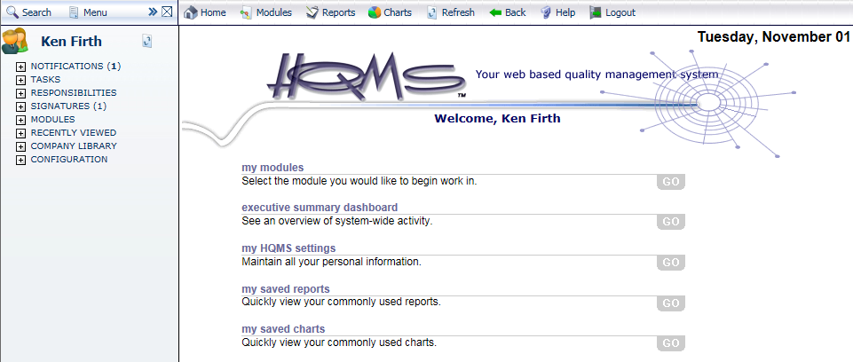
Additional Help
If you have any problems to use this system, there is an on-line help function that will take you to the HQMS site, which is more detailed than this short guide.
For the following actions, please contact your HYMH Procurement contact, HYMH SQE contact or the HYMH co-ordinator for guidance:
Having an ex-employee’s account closed.
Having an additional contact added to the system.
Having an ICAM re-assigned to another person in your organisation.

Slide 37
ICAM Questions to Verify Completeness

Slide 38
Revision Status
Revision Level | Title | Issued | Last revision | Revision Scope
1 | Addition of 5 Why template. | 15th June 2017 | 1st June 2017 | Addition slides 20 and 22 added.
2 | Further clarification on the importance to complete the E-signature. | 8th August 2017 | 15th June 2017 | Changes made to slides 17, 19, 24 and 26.
3 | Addition of note to verify the process within 2 days and not to delay until the return of the failed parts. | 23rd August 2017 | 8th August 2017 | Change made to slide 17.
4 | Changed the notes in best practice and added a new slide to show how to download and upload the 5 why template. | 5th October 2017 | 23rd August 2017 | Changed slide 3 and added slide 20
5 | Added in 5th Why examples, the 5th Why checklist and 9 ways to Define, Improve and Control Quality. | 13th March 2018 | 5th October 2017 | Added slides 23, 24, 25 and 26.
6 | Added in a note to advise Supplier to have the ICAM cancelled, and the debit reversed if the root cause was not linked to the supplier or the fault could not be replicated. | 27th December 2018 | 13th March 2018 | Slide 19
7 | Change to HQMS login address (https://hqms.hgihost.com/nmhg/login.aspx) | 20th August 2019 | 27th December 2018 | Slide 4
8 | Added in “Frequently Asked Questions (FAQs)”. | 29th January 2020 | 20th August 2019 | Slides 4, 5 and 6.
9 | Clarified that there is a different root cause for why made and why shipped on slide 3. Added more questions to Permanent Corrective action on slide 31 and added al questions to slide 37. | 09th July 2020 | 29th January 2020 | Slides 3, 31 and 37
10 | Updated the ICAM questions in the containment, root cause and permanent corrective action slides. | 30th September 2020 | 9th July 2020 | Slides 20, 22, 31 and 37.

