Slide 1

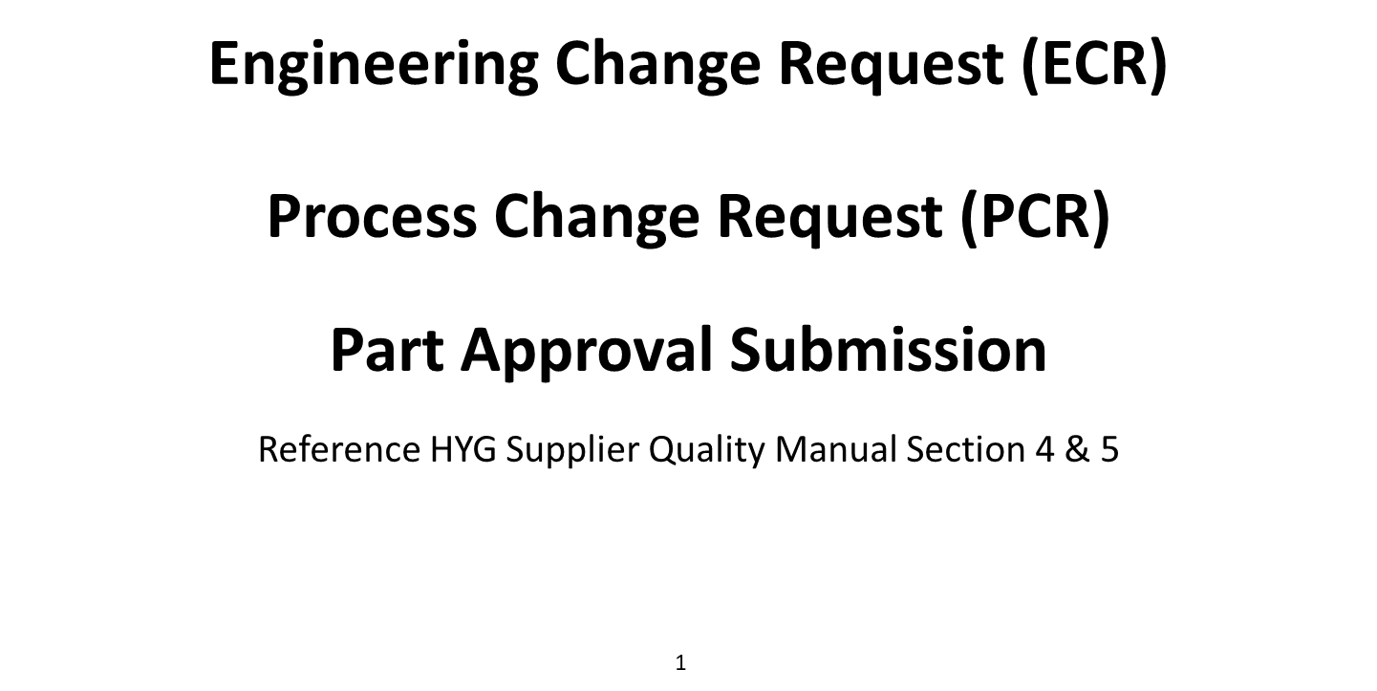

Slide 2
Jaggaer ECR / PCR and PA Submission
This presentation is an information training pack for the HYMH Change Request and Part Approval Submission Process. In an effort to better streamline communications with the supply base, we have created a new ECR, PCR and PA Submission Process within the Jaggaer system our Suppliers and HYMH Supply Chain Teams utilize.
While the system looks different, the functionality is the nearly the same, it’s easy to use and self-explanatory.
Change always has challenges and it’s typically with our ability to accept the need to learn a new way. With that said, we expect no functional or communication challenges with using the system. However, we do expect some system access challenges if Suppliers Do Not Maintain Contacts and Access within Jaggaer. Utilize the below procedure if you have any issues with system access or Quality Contacts.
  If you company needs Access To Jaggaer – Contact your HYMH Commodity Manager
  Adding your companies Quality Contact to Jaggaer – Follow Training in Attached
The following slides will guide you thru both the Supplier Quality Manual Requirements and the Jaggaer Process for submission. The guide will walk you thru ECR, PCR and PA Submission. You will notice common access methods, self-explanatory inputs, clear tracking of status and most importantly, both HYMH and the Supplier will receive email notifications each time there is an update to one of the submissions.
Note: When in doubt, pick up the phone. Contact your HYMH SQE, QE, QA, Commodity Manager or Supply Chain Associate. One of us will always help guide you to the correct person or method of resolution. Access challenges with Jaggaer or any other HYMH System is no excuse for not communicating or following procedures.
HYMH users needing access, please follow DCN 21105.

Slide 3
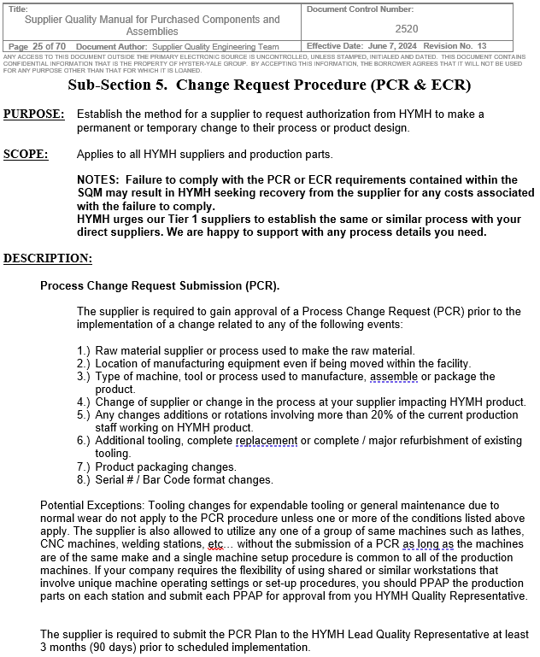
Supplier Quality Manual (SQM)
Note: The ECR process is for Mass Production Product Only. DO NOT SUBMIT CHANGE REQUESTS FOR PRE-PRODUCTION PARTS. These requests must go through your Project Lead.
3

Slide 4
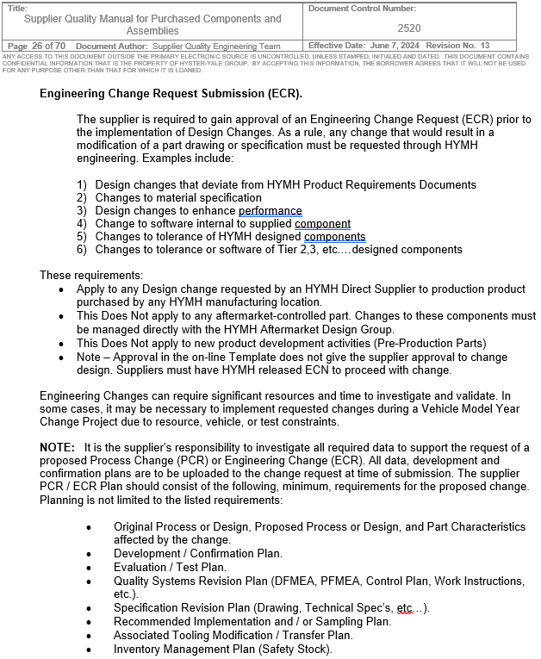
Supplier Quality Manual (SQM)
4

Slide 5
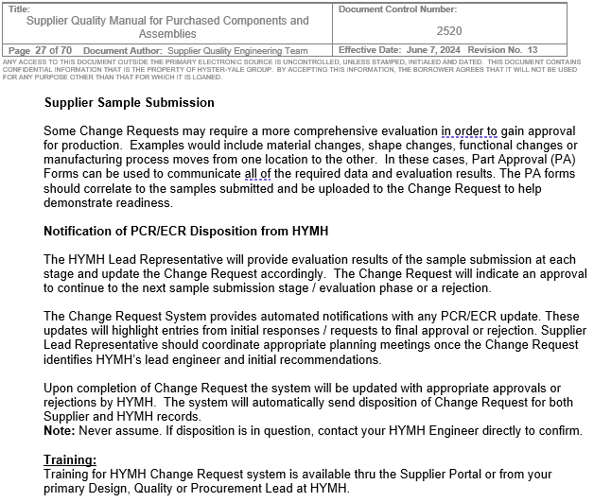
Supplier Quality Manual (SQM)
Hyster-Yale, Inc. - Hyster-Yale Supplier Documentation

Slide 6
ECR
Slides 7 – 17
Provide an overview of ECR Submission and input requirements

Slide 7
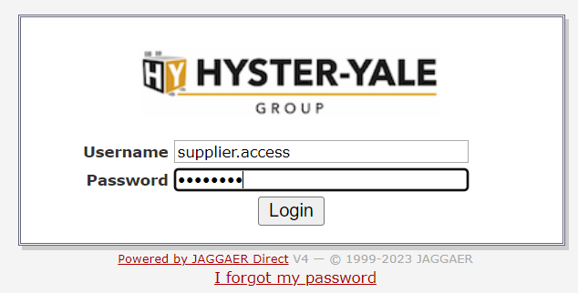
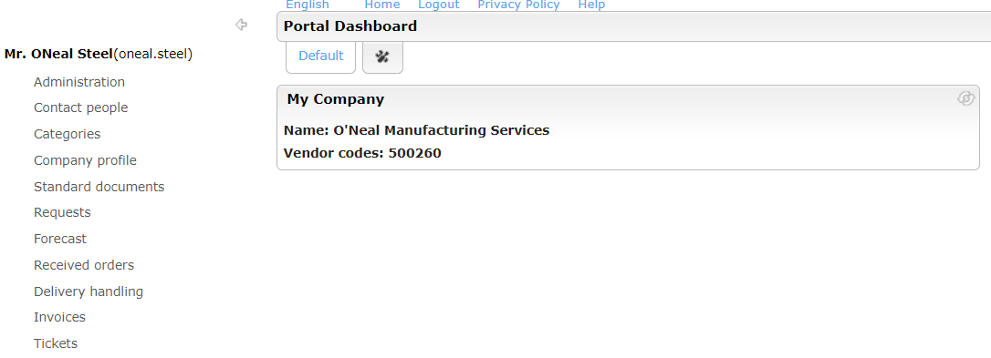
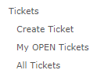
Jaggaer Change Request
https://suppliers.hyster-yale.com/portal/hyg/
Input username and password to log in (supplier)
Once logged in, supplier will have access to multiple business inputs / outputs links.
For PCR, ECR and PA, Select “Tickets”.
Once “Tickets” is selected, you will have an opportunity to:
Create a new Ticket for PCR, ECR or PA
Review your OPEN Tickets. Tickets that are in process (saved) or submitted to HYMH
Review ALL Tickets. All Open and Closed PCR, ECR or PA Tickets will be accessible

Slide 8
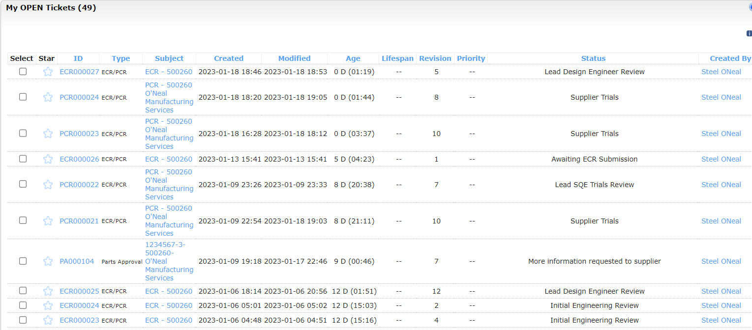
Jaggaer Change Request
Clicking My OPEN Tickets will list all your open tickets (PCR, ECR & PA) and Status
Navigate thru the tickets by clicking on the links

Slide 9
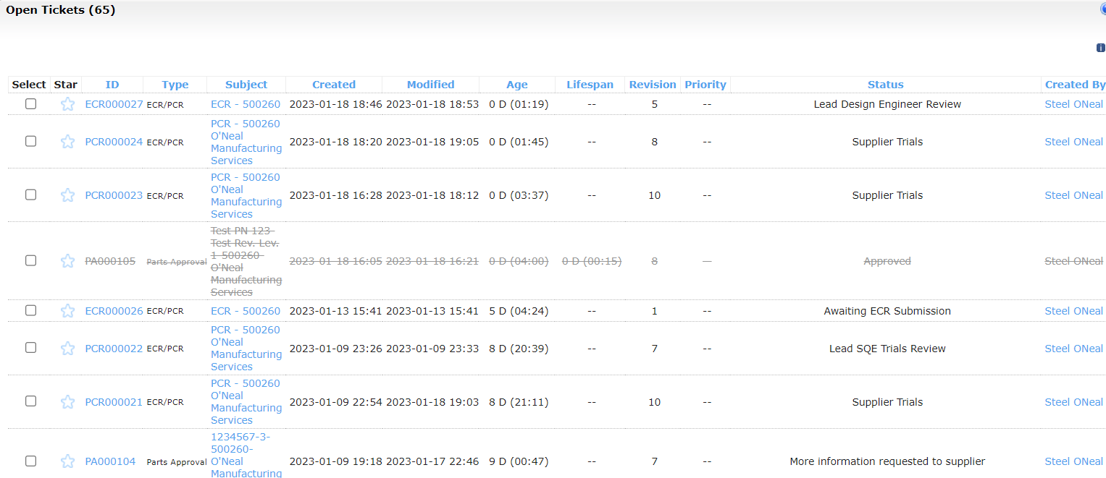
Jaggaer Change Request
Clicking All Tickets will list both open and closed PCR, ECR & PA Tickets and Status

Slide 10

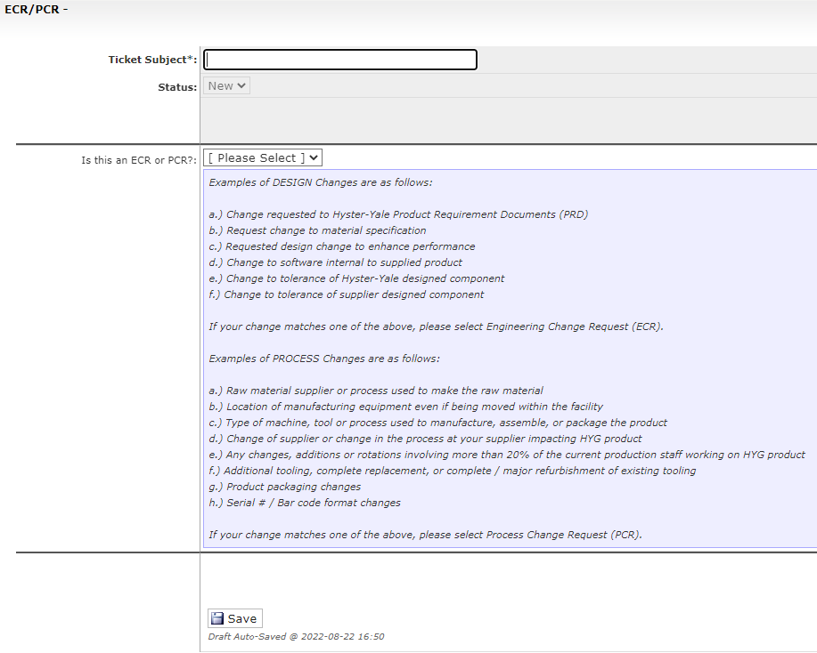
Jaggaer Change Request
Clicking Create Ticket starts the new Ticket (supplier)
Click drop down, select ECR/PCR and click Continue
Input General Subject
Confirm if this is a PCR or ECR based on SQM Definitions listed below
Once PCR or ECR is selected, click Save.

Slide 11
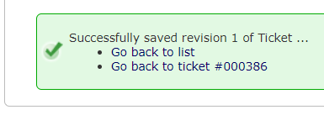
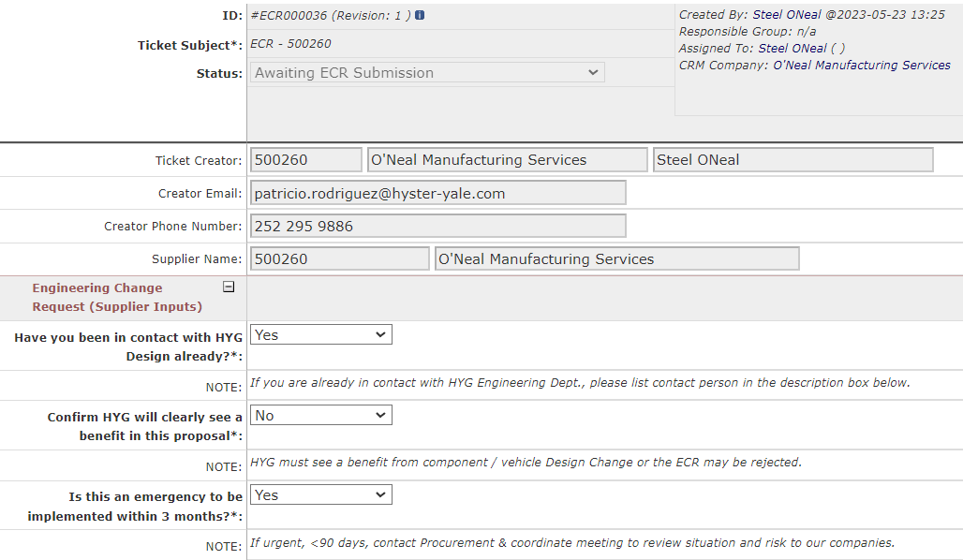
Jaggaer ECR Specific
After clicking Save you will be notified of success, the Ticket # and you will be provided a link to return to the ticket. You can also use the My Open Tickets link to access the ticket.
Click to open ticket for below inputs.
Some sections will auto populate based on your Jaggaer credentials and previous inputs
Three Yes or No Questions:
If you are already in contact / working with Design, you should list contact person in the description box below.
If there is no benefit for HYMH to make this design change then we should focus our resources elsewhere
If this is an emergency, contact your Commodity Manager as well to help coordinate activities to ensure consistent supply of quality parts
NOTE: Items in bold and identified with * are mandatory/required.

Slide 12
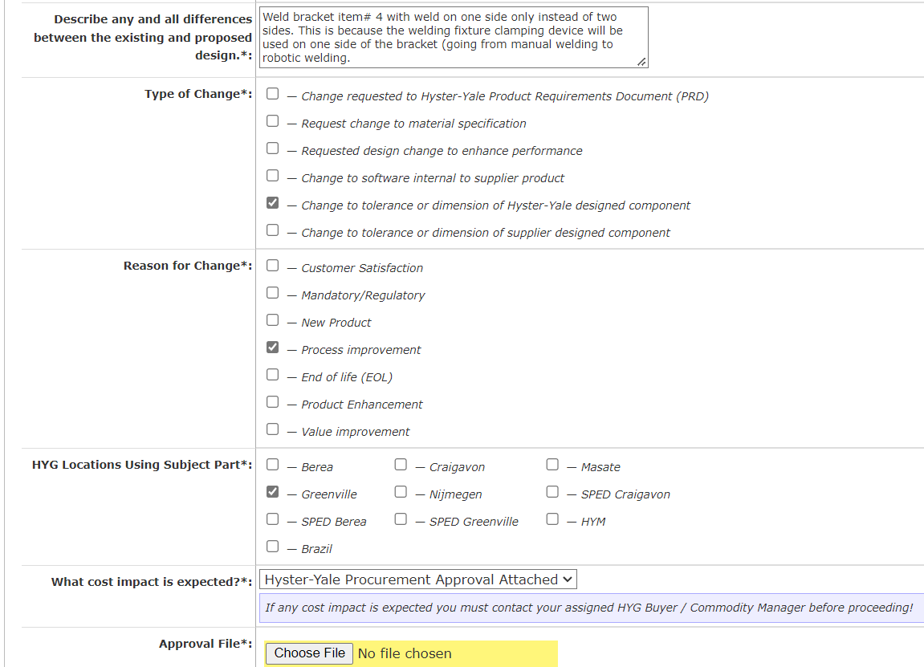
Jaggaer ECR Specific
Describe change content
Identify the type of change
Identify the reason for change
Identify HYMH locations impacted
Confirm if any cost increase.
If any cost increase is expected, you must first gain approval from your HYMH Commodity Manager and attach that approval to the ECR

Slide 13
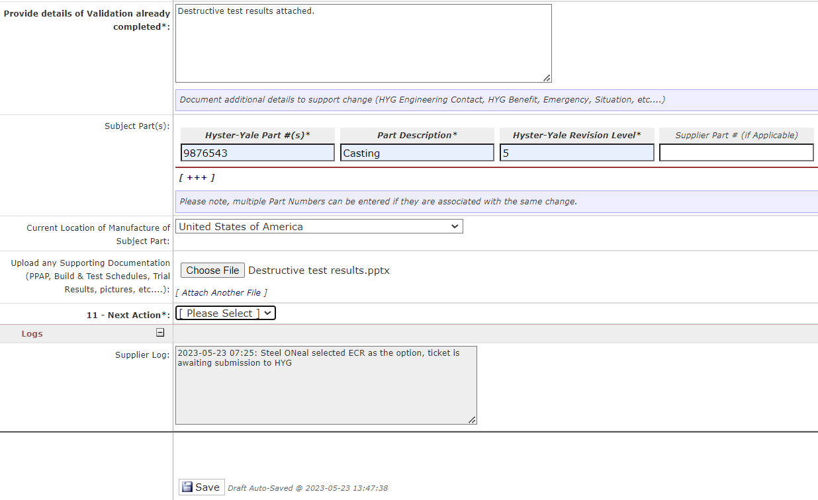

Jaggaer ECR Specific
Document any validation of change confirming its readiness. Below this section is a specified location to attach test reports and data
Input Part # Information. Clicking [+++] will allow you to input multiple part #’s
Add more part numbers.
Identify country of manufacture.
Upload Test and PPAP Data.
You can Save as a Draft and return to finish later using the My Open Tickets link or select Submit to HYMH and ECR will be sent to HYMH Engineering after clicking Save below.
This section is auto populated and shows time, general description and status of each update to the log.
Save Must Be Clicked. The above Submit to HYMH or Save as Draft selection just indicates where the final Save sends the ECR.

Slide 14
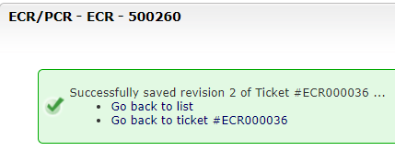
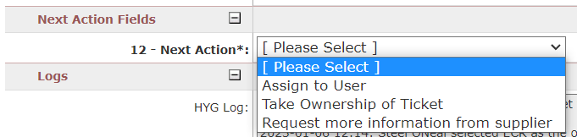
Jaggaer ECR Specific
After clicking Save you will be notified of success, the Ticket # and you will be provided a link to return to the ticket. You can also use the My Open Tickets link to access the ticket.
HYMH Design will get email notification of the new ECR being submitted and will see the ECR in their inbox
HYMH Design can:
Assign the ECR to an Engineer
Reviewer can take ownership and work on it themselves
Request more information from the supplier.
In this example, HYMH Design requested more information so supplier will receive the ECR back and status will be “Awaiting ECR Submission”. Supplier will update the ECR accordingly and resubmit.

Slide 15
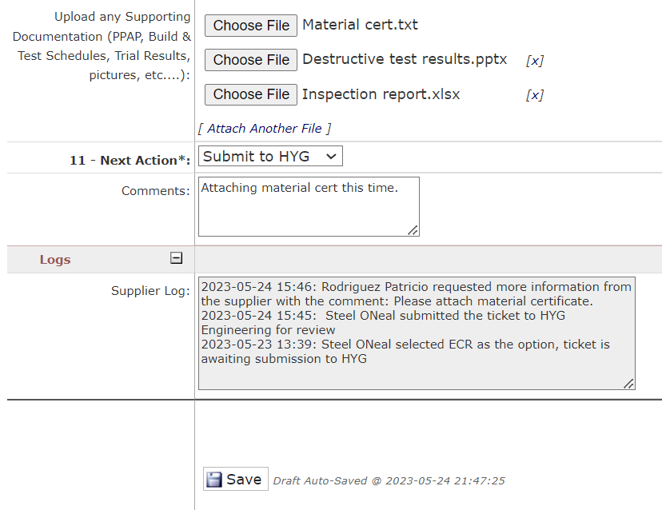
Jaggaer ECR Specific
Supplier should upload appropriate data, select Submit to HYMH and click the Save button at the bottom of the form. This will transfer the ECR to HYMH.
NOTE: Supplier can attach more files clicking [Attach Another File].
Once ECR is opened the log of submissions will show the status of the ECR. In this case requesting material certificate.
Save Must Be Clicked. The above Submit to HYMH or Save as Draft selection just indicates where the final Save sends the ECR.

Slide 16
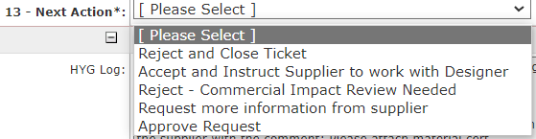
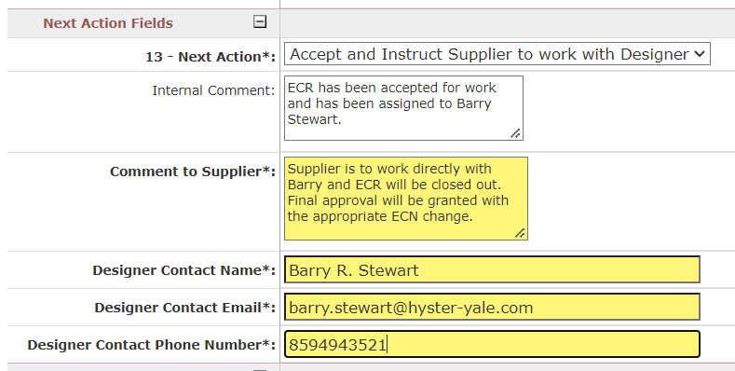
Jaggaer ECR Specific
HYMH Design will receive updated ECR and will select one of the drop-down options.
Any of these status updates except for, Request More Information, will close the ticket and return it to the supplier's inbox under All Tickets.
NOTE: Approve Request means straight approval, no need to work with Designer.
If HYMH accepts the ECR to work with Designer, the owner will update with comments visible to all.
HYMH contact information will be provided and supplier is expected to work directly with that contact.
If the Design Change is approved, the next step will be to document that change with an ECN and associated document change (Drawing, PRD, etc…)

Slide 17
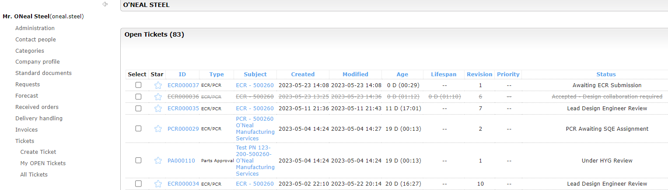
Jaggaer ECR Specific
Supplier will be able to find the Approved or Rejected ECR in the All Tickets view. Remember that any Closed Ticket will have a line thru it. All other tickets are still active / open.

Slide 18
PCR
Slides 19 – 29
Provide an overview of PCR Submission and input requirements

Slide 19
Jaggaer Change Request
Clicking Create Ticket starts the new Ticket (supplier)
Click drop down, select ECR/PCR and click Continue
Input General Subject
Confirm if this is a PCR or ECR based on SQM Definitions listed below
Once PCR r ECR is selected, click Save.

Slide 20
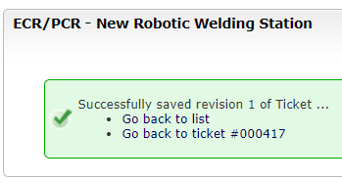
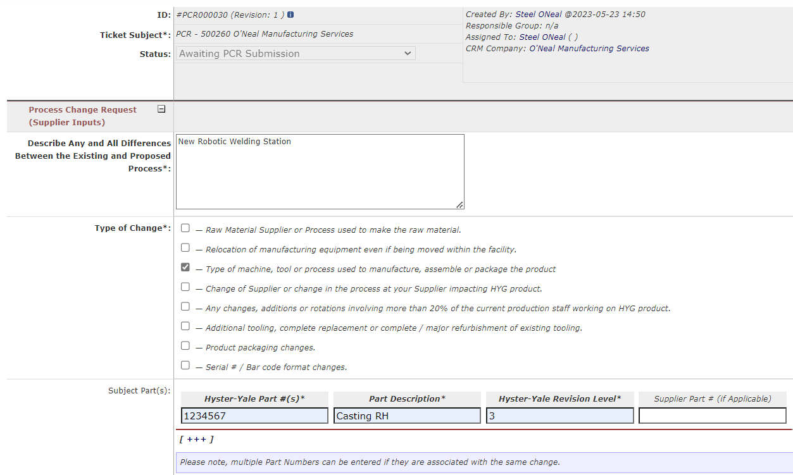
Jaggaer PCR Specific
After clicking Save you will be notified of success, the Ticket # and you will be provided a link to return to the ticket. You can also use the My Open Tickets link to access the ticket.
Some sections will auto populate based on your Jaggaer credentials and previous inputs
Describe change content
Check off on change category
Input Part # information. Clicking [+++] will allow for input of multiple part #’s
Add more part numbers.

Slide 21
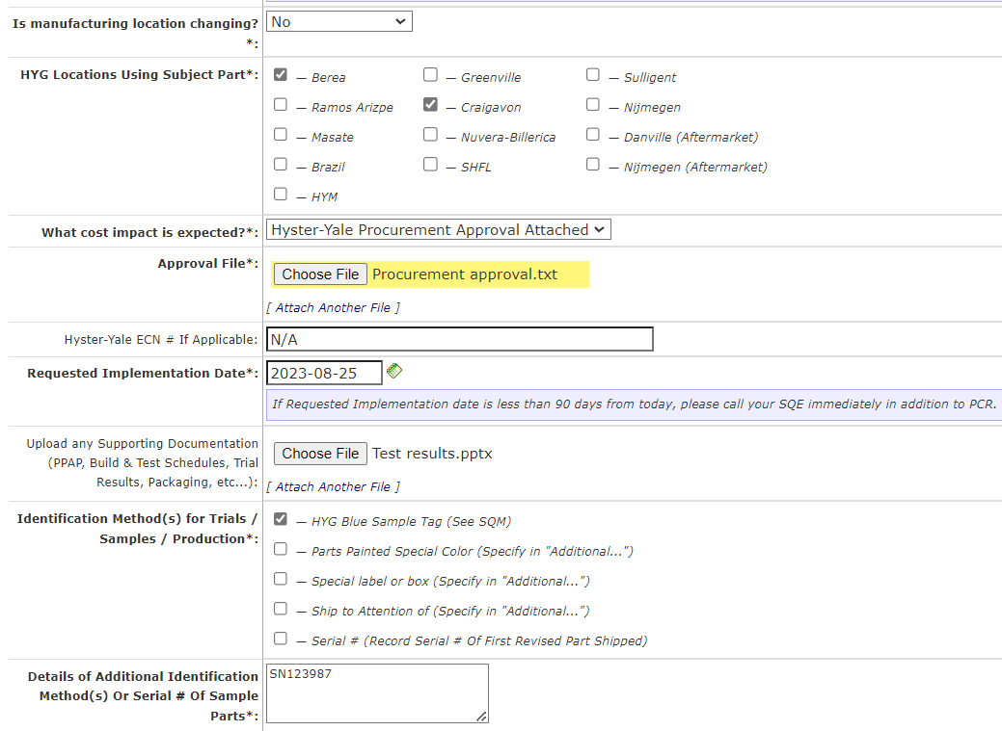
Jaggaer PCR Specific
Yes or No? If Yes, inputs are required to document the current and new locations
HYMH Locations Impacted
Confirm if any cost increase.
If any cost increase is expected, you must first gain approval from your HYMH Commodity Manager and attach approval to the PCR
<90 Days = Urgent. Call SQE/Procurement directly in addition to PCR
Attach required Plan and Validation results required
Document identification method and other special notes

Slide 22
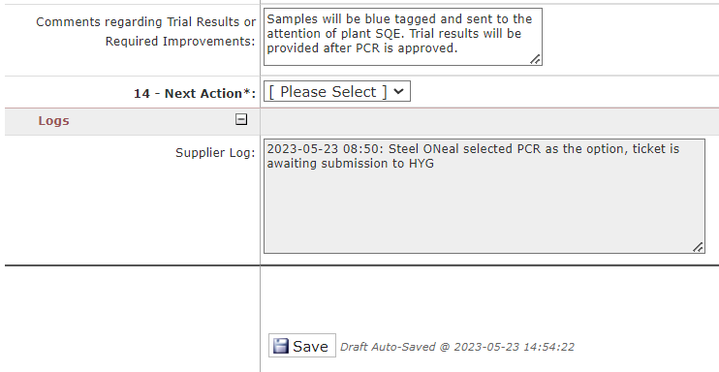

Jaggaer PCR Specific
Provide additional comments as needed
You can Save as a Draft and return to finish later using the My Open Tickets link or select Submit to HYMH and PCR will be sent to HYMH SQE after clicking Save below.
This section is auto populated and shows time, general information and status of each update to the log.
Save Must Be Clicked. The Submit to HYMH or Save as Draft selection just indicates where the final Save sends the PCR

Slide 23
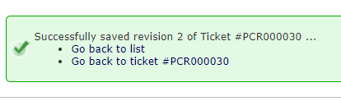
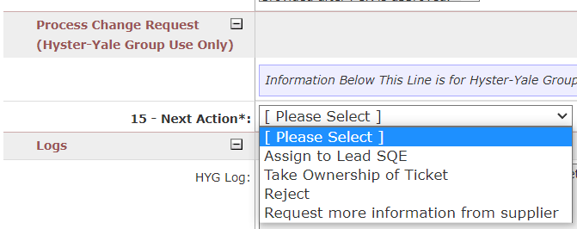
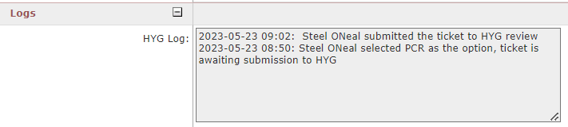
Jaggaer PCR Specific
After clicking Save you will be notified of success, the Ticket # and you will be provided a link to return to the ticket. You can also use the My Open Tickets link to access the ticket.
HYMH SQE will get email notification of the new PCR being submitted and will see the PCR in their inbox
PCR will be assigned, owned by SQE reviewer, rejected or request more information from supplier
Status Log will document each change in status

Slide 24
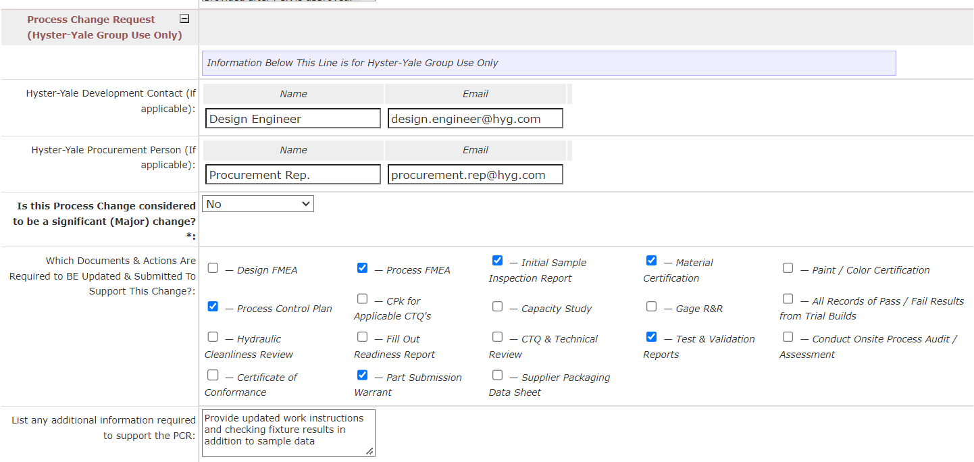
Jaggaer PCR Specific
SQE will identify the appropriate Design and Procurement representative when needed
SQE will identify required Process and Quality Documentation

Slide 25
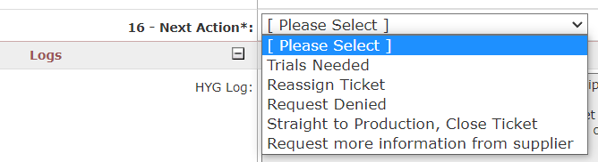
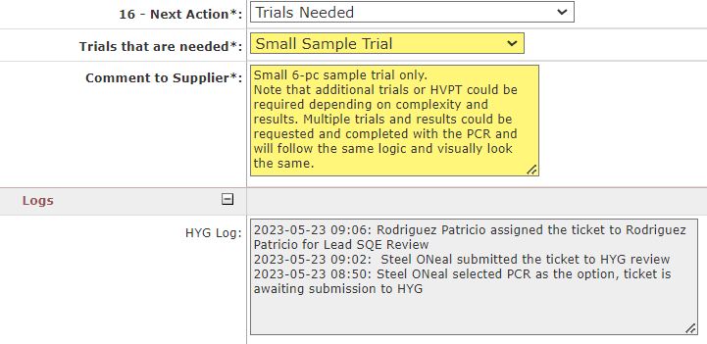
Jaggaer PCR Specific
SQE will initially select the next step for ticket
If Trials are needed the appropriate Small Sample or HVPT will be selected. System allows for multiple trials to be conducted when necessary. These additional Trials will show up as selected and any special notes will be added to support (data requirements, packaging, etc.)
System log continuously tracks updates
Save Must Be Clicked. The Trials Needed selection above just indicates where the final Save sends the PCR.

Slide 26
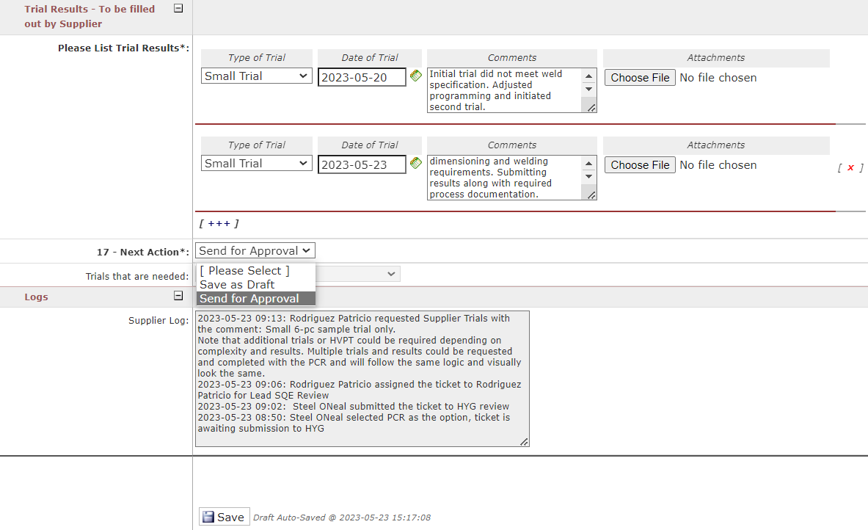
Jaggaer PCR Specific
Supplier gets e-mail notification and ticket review will show updated status “Supplier Trials”
Supplier updates with trial results and uploads files for confirmation.
In this example supplier used [+++] to add a second trial result initiated after errors identified
You can Save as a Draft and return to finish later using the My Open Tickets link or select Submit to HYMH and ECR will be sent to HYMH Engineering after clicking Save below.
Log continues to track all changes
Save Must Be Clicked. The Send for Approval or Save as Draft selection just indicates where the final Save sends the PCR

Slide 27
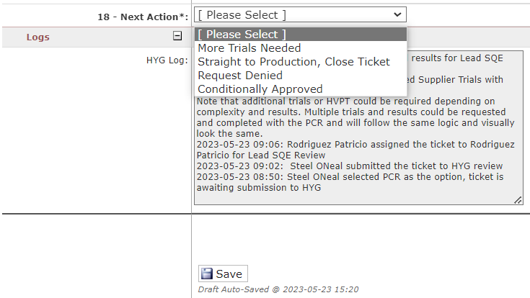
Jaggaer PCR Specific
HYMH SQE gets e-mail notification and ticket review will show updated status “Lead SQE Trials Review”
SQE will confirm the results and:
Initiate more trials
Approve for going straight to production
Deny Request (trials failed / change cancelled)
Conditionally Approve for production with clear improvement plan and timing.
← Log continues to track all changes
After Saving the PCR will be routed back to supplier

Slide 28
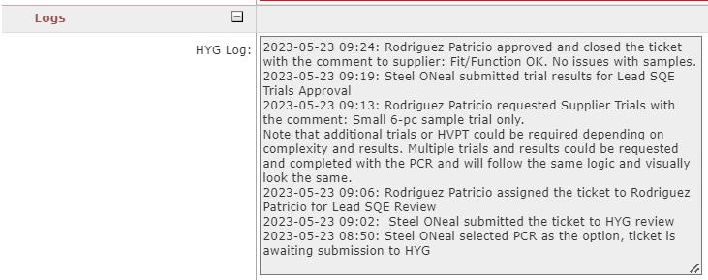
Jaggaer PCR Specific
Supplier gets email notification; system will show PCR status. In this example, ticket was approved and closed:
Open or Closed, the Log will show the status of the PCR/ECR along with a date and time record.

Slide 29
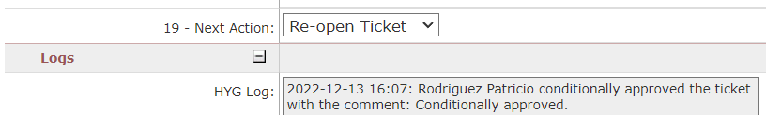
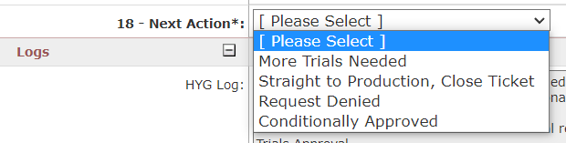
Jaggaer PCR Specific
If ticket is Conditionally Approved, SQE will be able re-open ticket and can change status based on additional corrective actions at the supplier
Options after re-opening. Selecting More Trials Needed will keep the ticket open for data exchange.

Slide 30
Part Approval Submission
Slides 31 – 38
Provide an overview of the PA Submission process and input requirements
APPROVED

Slide 31
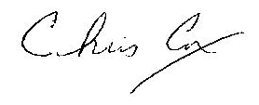
Part Approval Submission
To ensure Quality is “built in” to HYMH lift trucks, it is important for suppliers to confirm supplied parts comply to published standards and requirements. Since the implementation of our Supplier Quality Manual is 2001 it has been expected that all suppliers utilize a comprehensive Part Approval procedure to facilitate proof of compliance, when applicable new releases or changes occur. This enables HYMH to process parts more effectively and efficiently and avoid delays and costs due to non-conformances identified upon receipt.
To further facilitate the communication and confirmation of compliance, HYMH has is launching a new Jaggaer portal to receive the applicable data prior to receipt of the parts. HYMH will use this data to confirm parts are fully compliant to the drawing including any critical to quality or Key characteristics. Suppliers are expected to take the appropriate steps to ensure internal processes execute and deliver the applicable Part Approval data prior to shipment of parts.
Routing the parts through HYMH Quality Assurance to be validated, due to the absence of data from the supplier, is considered a non-standard process and will likely result in notification of non-conformance. Therefore, it is extremely important to ensure your company has the necessary processes and procedures in place to ensure issuance of Part Approval to HYMH prior to parts shipping.
The following slides will explain when , how and what to submit to HYMH for future shipments. Please communicate these expectations to the appropriate staff A.S.A.P. and feel free to contact me if you have any questions.
Vice President – Global Quality

Slide 32
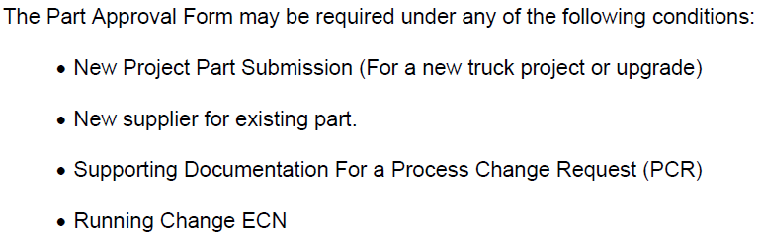
Part Approval Submission
When do I submit?
(Per Section 4 of the HYMH Supplier Quality Manual)

Slide 33
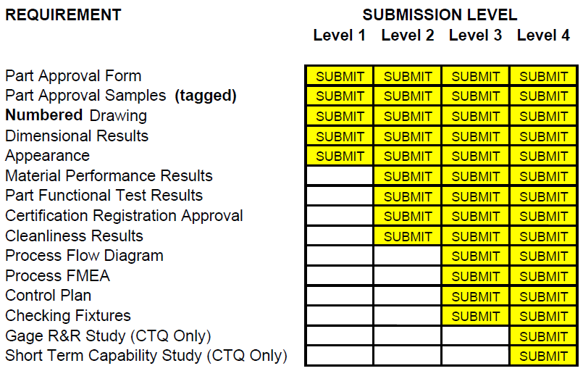
Part Approval Submission
Unless you are informed otherwise, by HYMH, a minimum of a level 2 Part Approval is required prior to the receipt of parts at any of our global manufacturing sites.

Slide 34
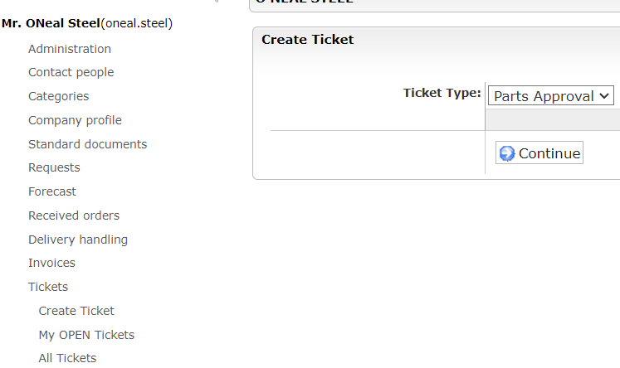
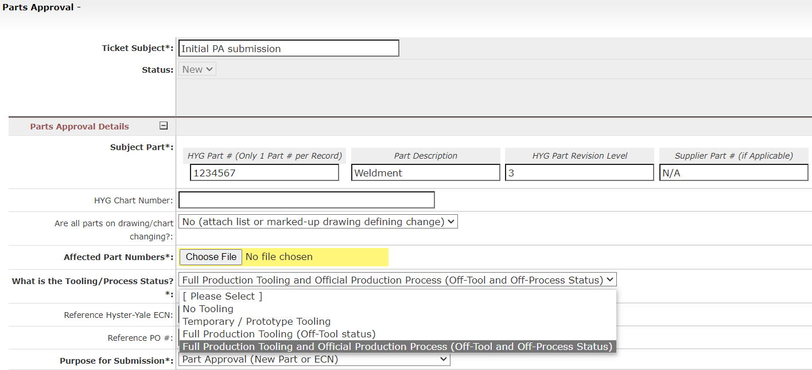
Part Approval Submission
Select Create Ticket
Choose Parts Approval
Click Continue and Input Screen will appear
Input General Subject
Input Part # Information
Drawings may define assemblies and all charted components must be confirmed and submitted per SQM. If ECN Revisions change individual components, the supplier is still expected to review each drawing, confirm and document the total change content to ensure no change content is missed.
Production parts are expected to be both Off Tool and Off Process (SQM Sec. 4). In some instances, HYMH may procure early prototype parts for initial trials. Please clearly indicate what level of tooling was used for the submission.

Slide 35

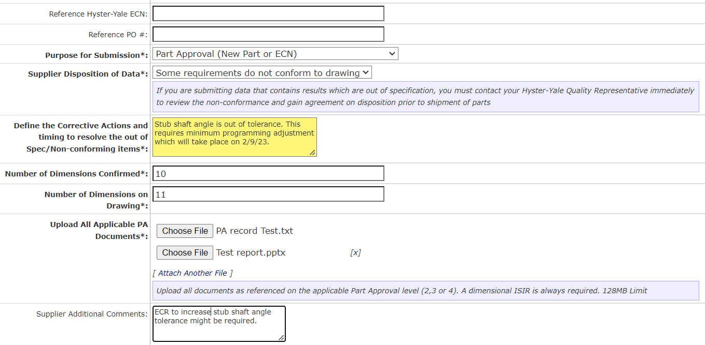

Part Approval Submission
If submitting ISIR only for initial samples, you are required to return and complete the full PA Submission
Document ECN and PO #
If anything is out of specification, CAPA must be clear and contact your HYMH Quality Representative
Multiple files can be uploaded
Additional notes can be added

Slide 36
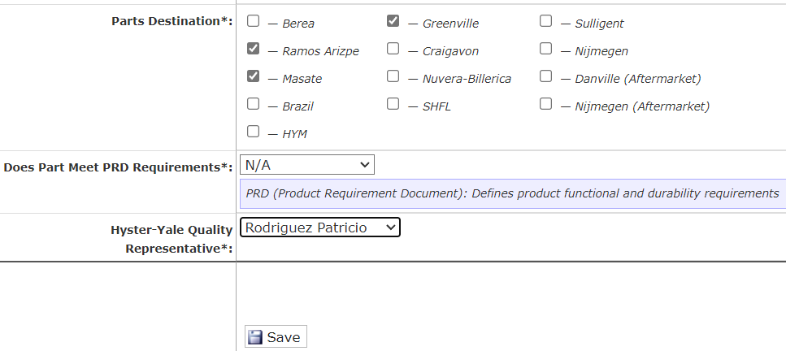
Part Approval Submission
HYMH Locations Impacted
If drawing specifies a Product Requirements Document, results must be included
Select quality contact (SQE or QE) from the list
Save Must Be Clicked To Submit!

Slide 37
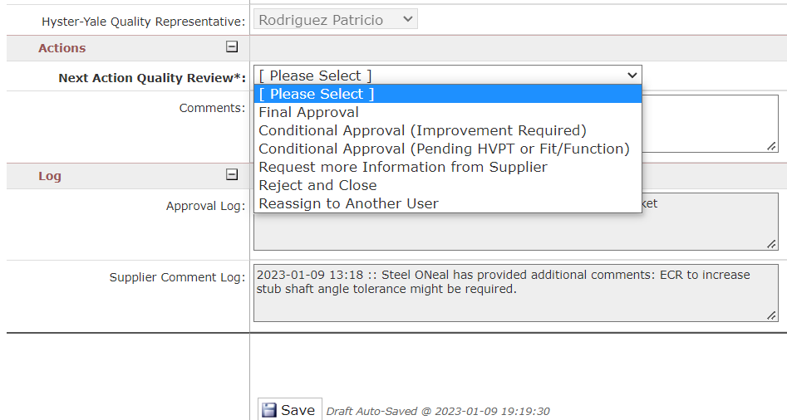
Part Approval Submission
HYMH SQE/QE gets e-mail notification and ticket review will show updated status “Quality Review”
Assigned SQE/QE Representative will confirm submission
SQE/QE will confirm submission and give direction per drop down list.
All updates and comments will be automatically logged for future reference.
NOTE: Approval or Rejection Status will be made clear, and comments provided to support required activities

Slide 38
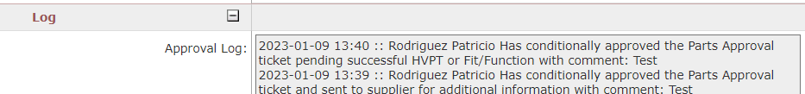

Part Approval Submission
Supplier gets email notification; in this case PA was fully approved, system will show updated status “Approved” with the line indicating submission is closed.
The Log will show the status of the PA along with a date and time record.

Slide 39
Part Approval Submission
Slides 40 – 42
Provide an overview of the PA Submission Request (from HYMH to supplier) process and input requirements.
Note: supplier is responsible to submit PA regardless of system request being received or not.
APPROVED

Slide 40
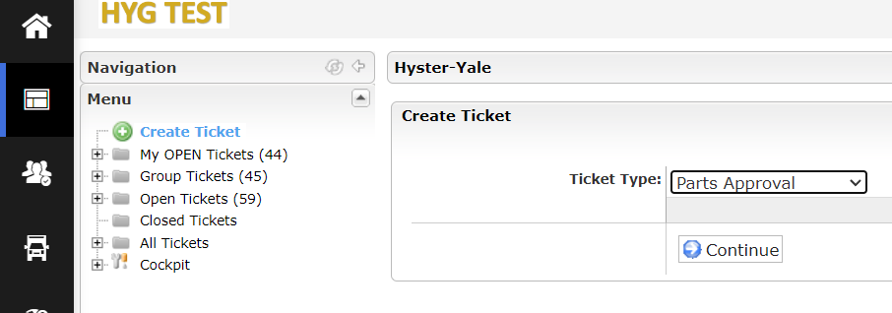
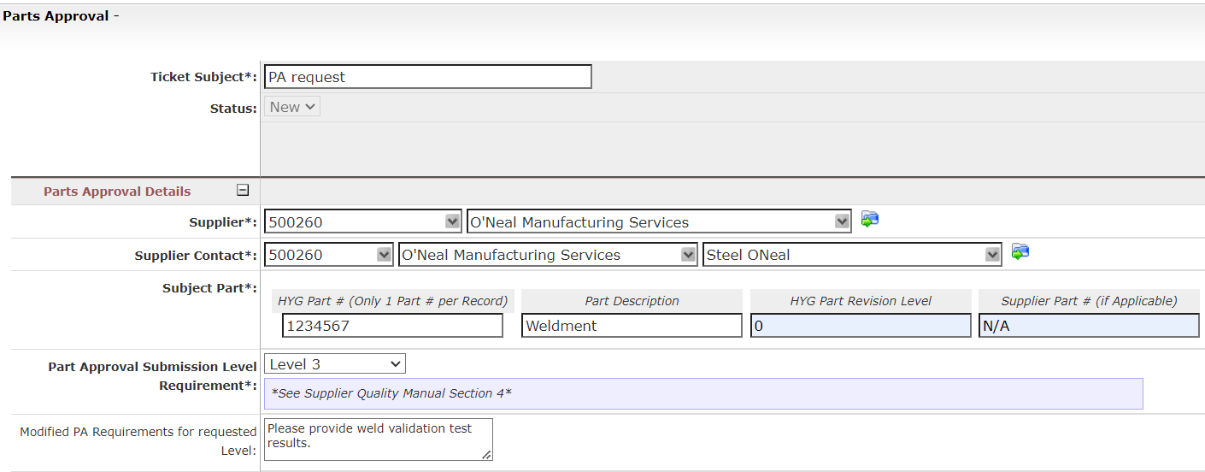
Part Approval Submission – HYMH Request
Go to “Dashboard”, Select “Create Ticket”
Choose “Parts Approval”
Click Continue and Input Screen will appear
Input General Subject
Select vendor code and supplier contact from the drop-down menu
Input Part # Information
Select PA Submission Level and provide additional requirements (modified PA requirements for requested level)

Slide 41
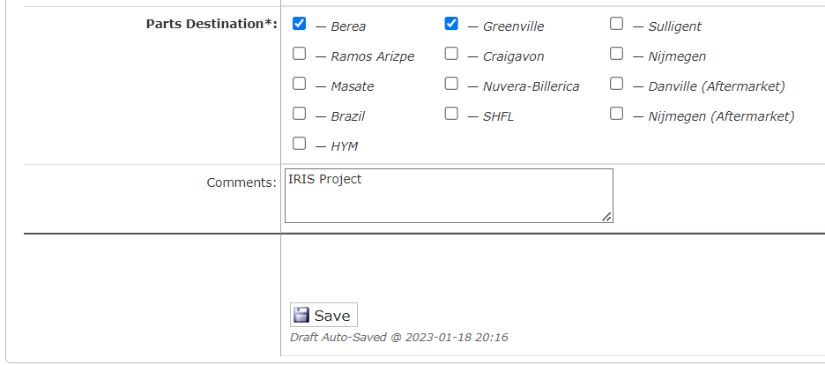
Part Approval Submission – HYMH Request
HYMH Locations Impacted
Provide additional comments (if any)
Save Must Be Clicked To Submit!
Supplier gets e-mail notification and ticket review will show status “Awaiting Supplier Submission”.

Slide 42
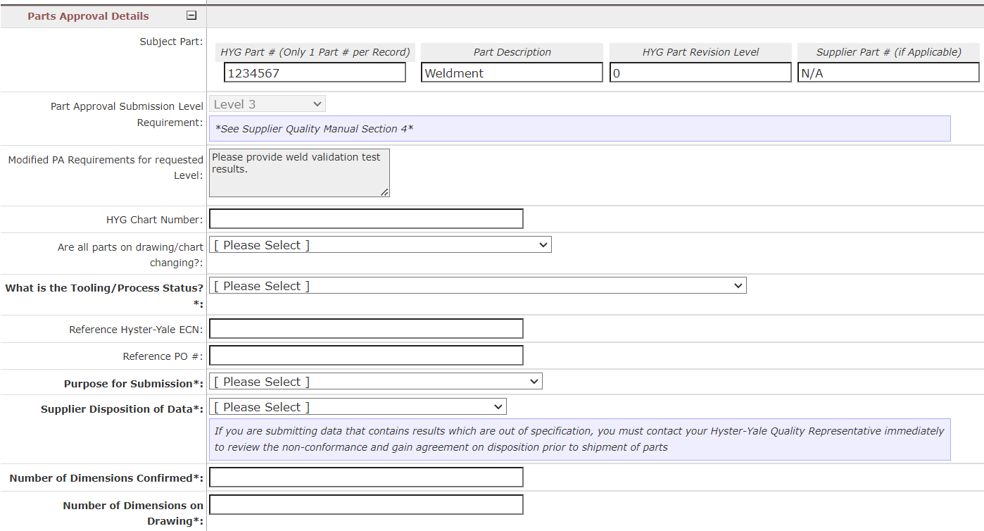

Part Approval Submission – HYMH Request
Supplier will complete PA and submit to HYMH for approval (same inputs as previous PA Submission Example).

Slide 43
Part Approval Submission – HYMH Request
In Summary
Ensure all new parts fit, form and functional characteristics are compliant to the HYMH drawing and Product Specification Requirement Document (PRD) if applicable.
Have a system in place to ensure Initial Sample Inspection Reports (ISIR’s) and Part Approval Packages are submitted in advance of shipping parts to HYMH. These documents will be referenced when receiving the parts into stock.
Contact your HYMH Quality representative if any part non-conformances are identified before shipping parts to HYMH.

Slide 44
Part Approval Submission – HYMH Request
Slides 45 – 48
Provide a guide for a better understanding of Jaggaer Approval Process.
APPROVED

Slide 45
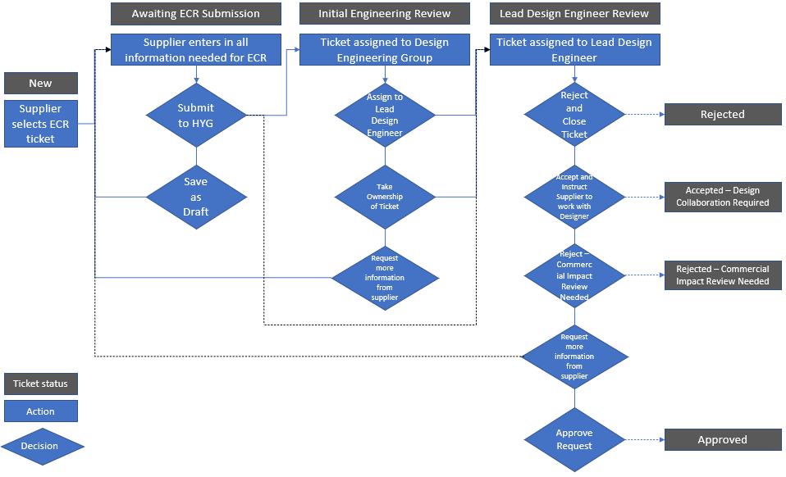
ECR Approval Workflow

Slide 46
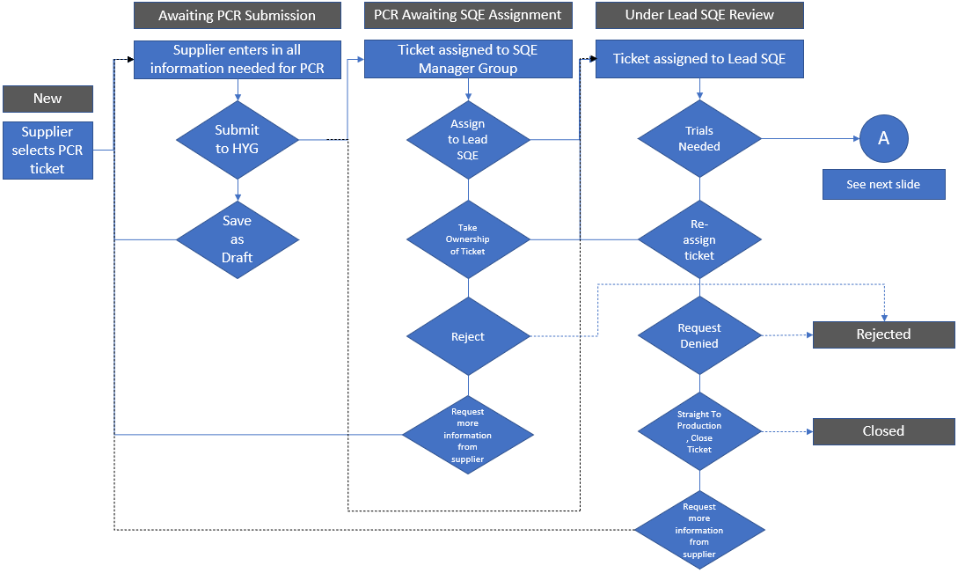
PCR Approval Work Flow

Slide 47

Part Approval WorkFlow

Slide 48

Part Approval WorkFlow

Slide 49

Questions
If you have any questions or queries regarding these processes, please contact your local Supplier Quality Engineer, Plant Quality Representative or Design Engineer.

